Slide 1
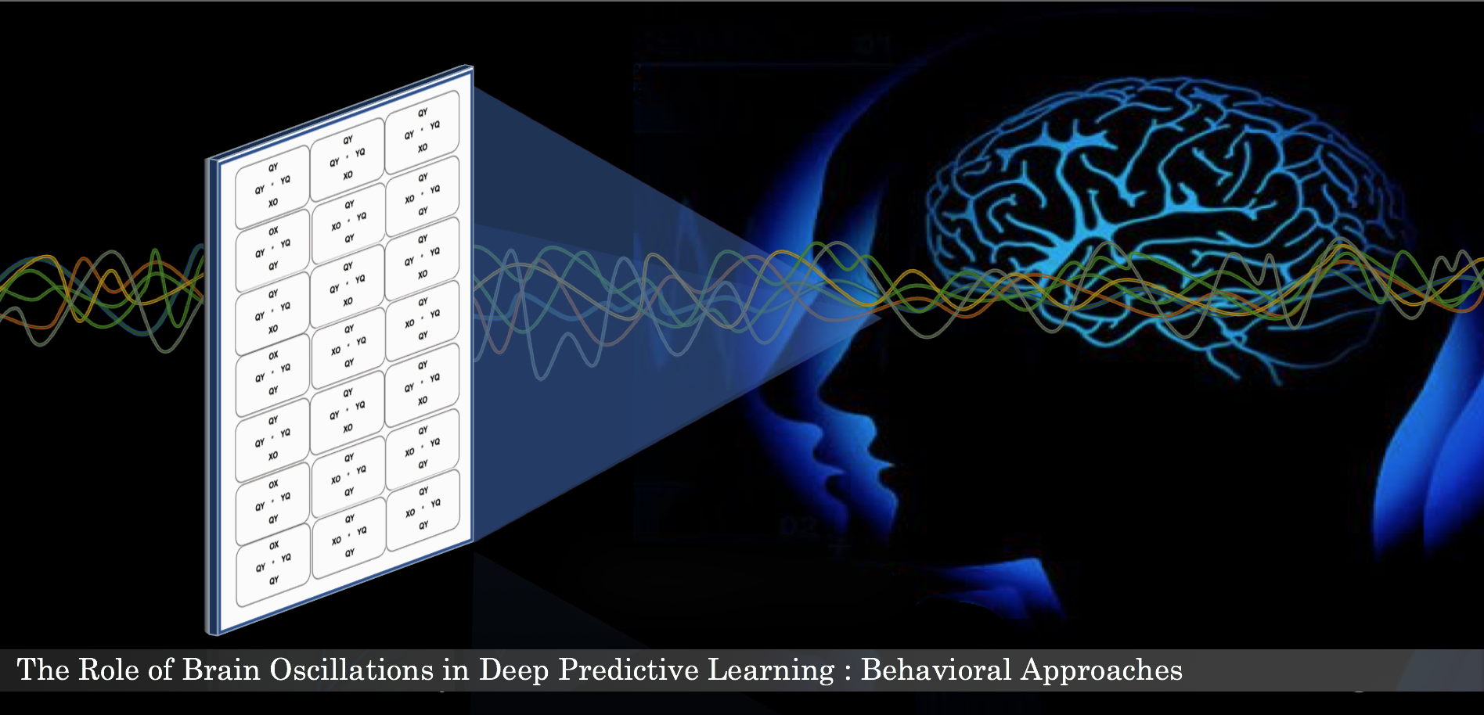
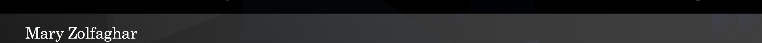

042219
Supervisor: Prof. Randall O’Reilly

Slide 2
Introduction
Experiments
Preliminary Results
Summary
Discussion
Future Steps

Slide 3
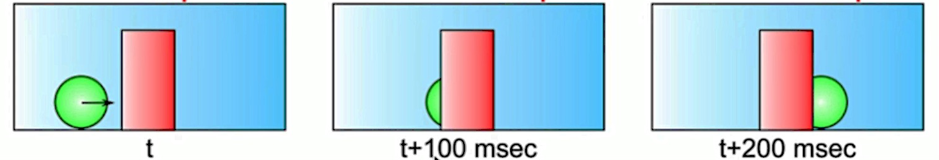
Predictive learning
Intro.
Exp.
Res.
We are constantly predicting our future
Learning signals (i.e., the prediction error) driven by the difference between the brain’s top-down prediction and bottom-up real world information
Hypothesis: Predictive learning occurs based on a temporal organization (alpha cycle, ~100ms).
Sum.
Disc.
Fut.

Slide 4
Alpha band oscillation
Intro.
The alpha rhythm refers to brain oscillations within a frequency range of 8–12 Hz.
Different Alpha roles
“Idling” state
Alpha associated with attentional modulation
Alpha associated with prediction
(Top-down role in beta activity in addition to its roles during the motor inhibition (Fiebelkorn and Kastner, 2019))
Exp.
Res.
Sum.
Disc.
Fut.
Notes:
Alpha band reflects an “idling” state in which the underlying cortical regions are not engaged in any task related sensory information
Top-down attentional processing results in reduced alpha power in attended and higher alpha power in unattended areas
Low-frequency oscillations provide predictions via feedback connections, while gamma oscillations signal the mismatch of sensory input to these predictions (the prediction error) via feedforward connections.

Slide 5
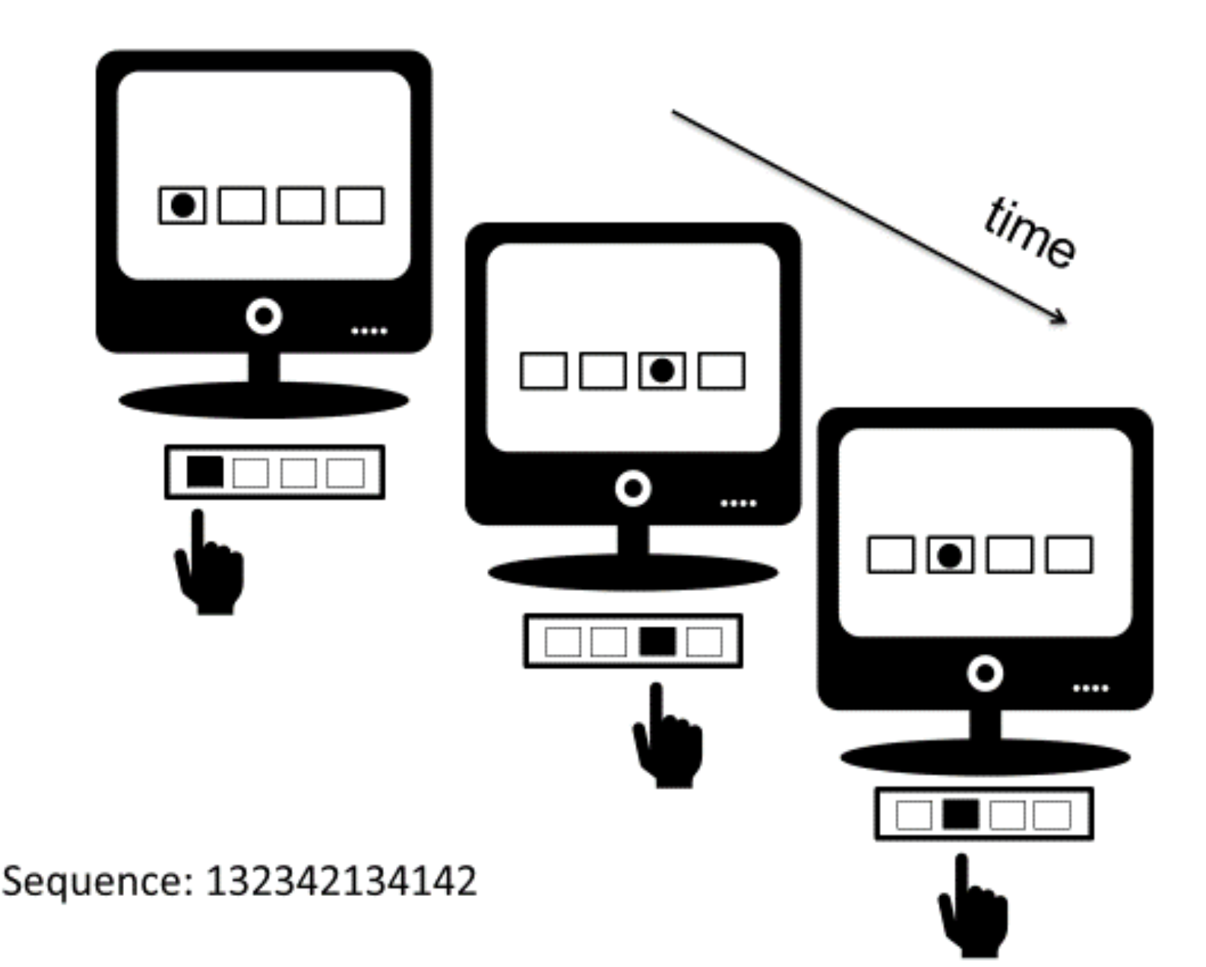
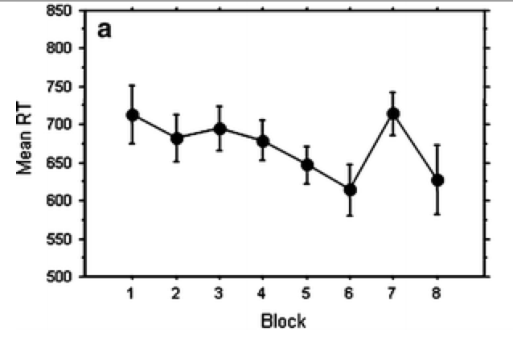
Sequence learning
Intro.
Exp.
Transition Effect
Res.
Sum.
Disc.
Fut.

Slide 6
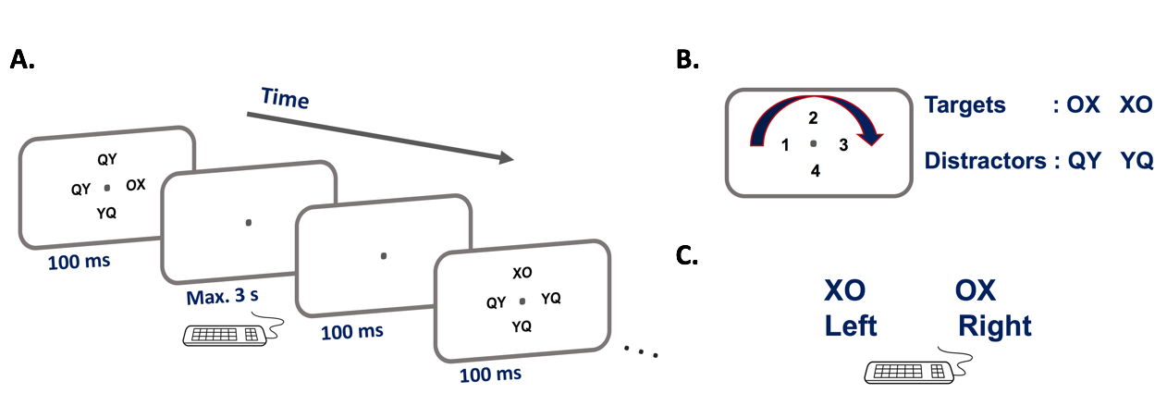
Experimental paradigm
Intro.
Exp.
Res.
Sum.
Disc.
Fut.
N. Deroost et. al, “Spatial processing and perceptual sequence learning in SRT tasks” Exp. Psychol., 2006.

Slide 7
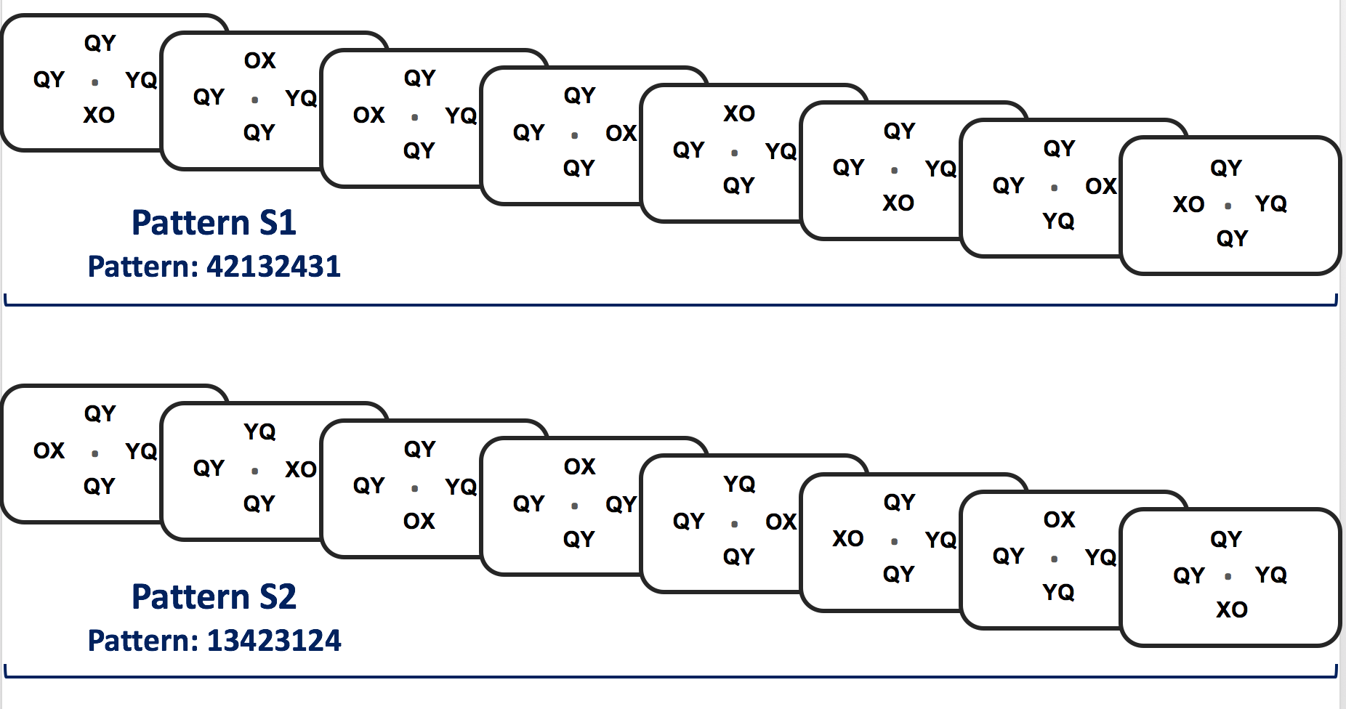
Intro.
Exp.
Res.
Sum.
Disc.
Fut.

Slide 8
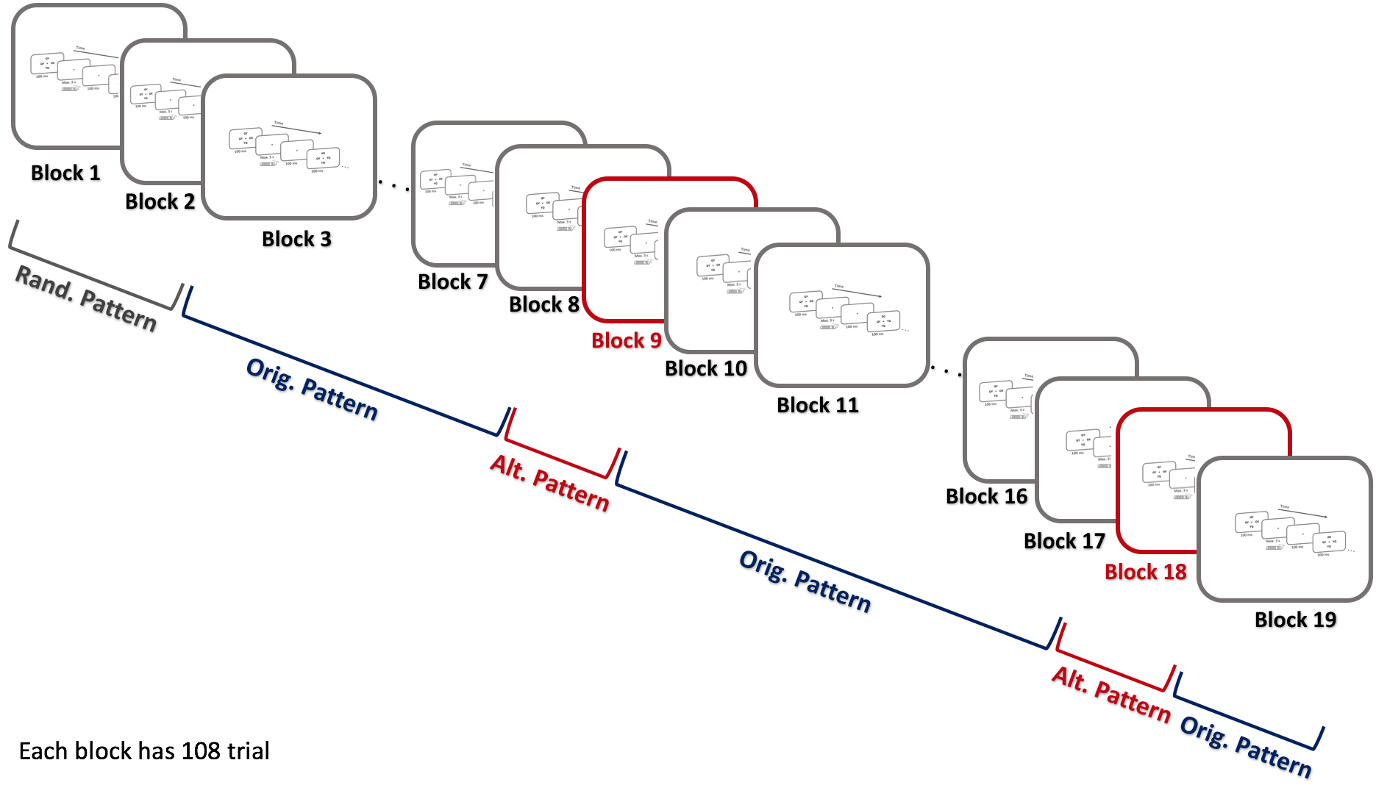
Experiment 1
Goal:
Replicate the sequence learning without including any motor related learning
Questions:
Can people learn the sequence implicitly and without the association with their motor responses?
When the sequence learning will happen (during the first or second half of the experiment)?
Do the position of the targets (XO/OX) affect learning?
Intro.
Exp1.
Res.
Sum.
Disc.
Fut.
Corpus callosum involved in covert attentional shifts across visual hemispheres
Reuter-Lorenz et al.2007

Slide 9
Experiment 1
Intro.
Exp1.
Res.
Sum.
Disc.
Fut.

Slide 10
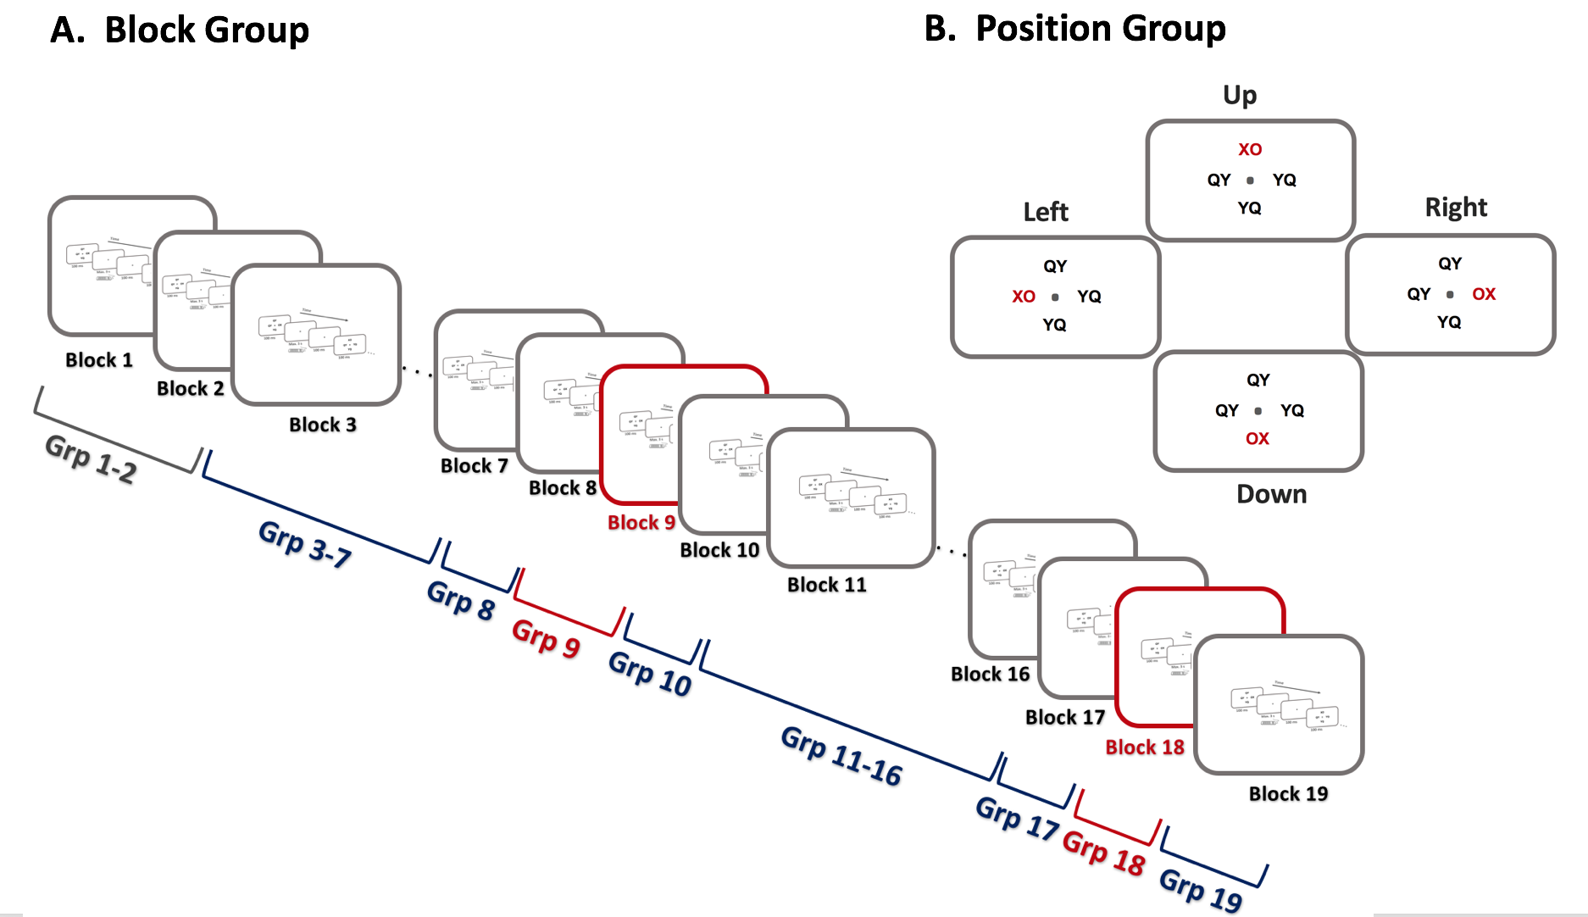
Intro.
Exp1.
Res.
Sum.
Disc.
Fut.

Slide 11
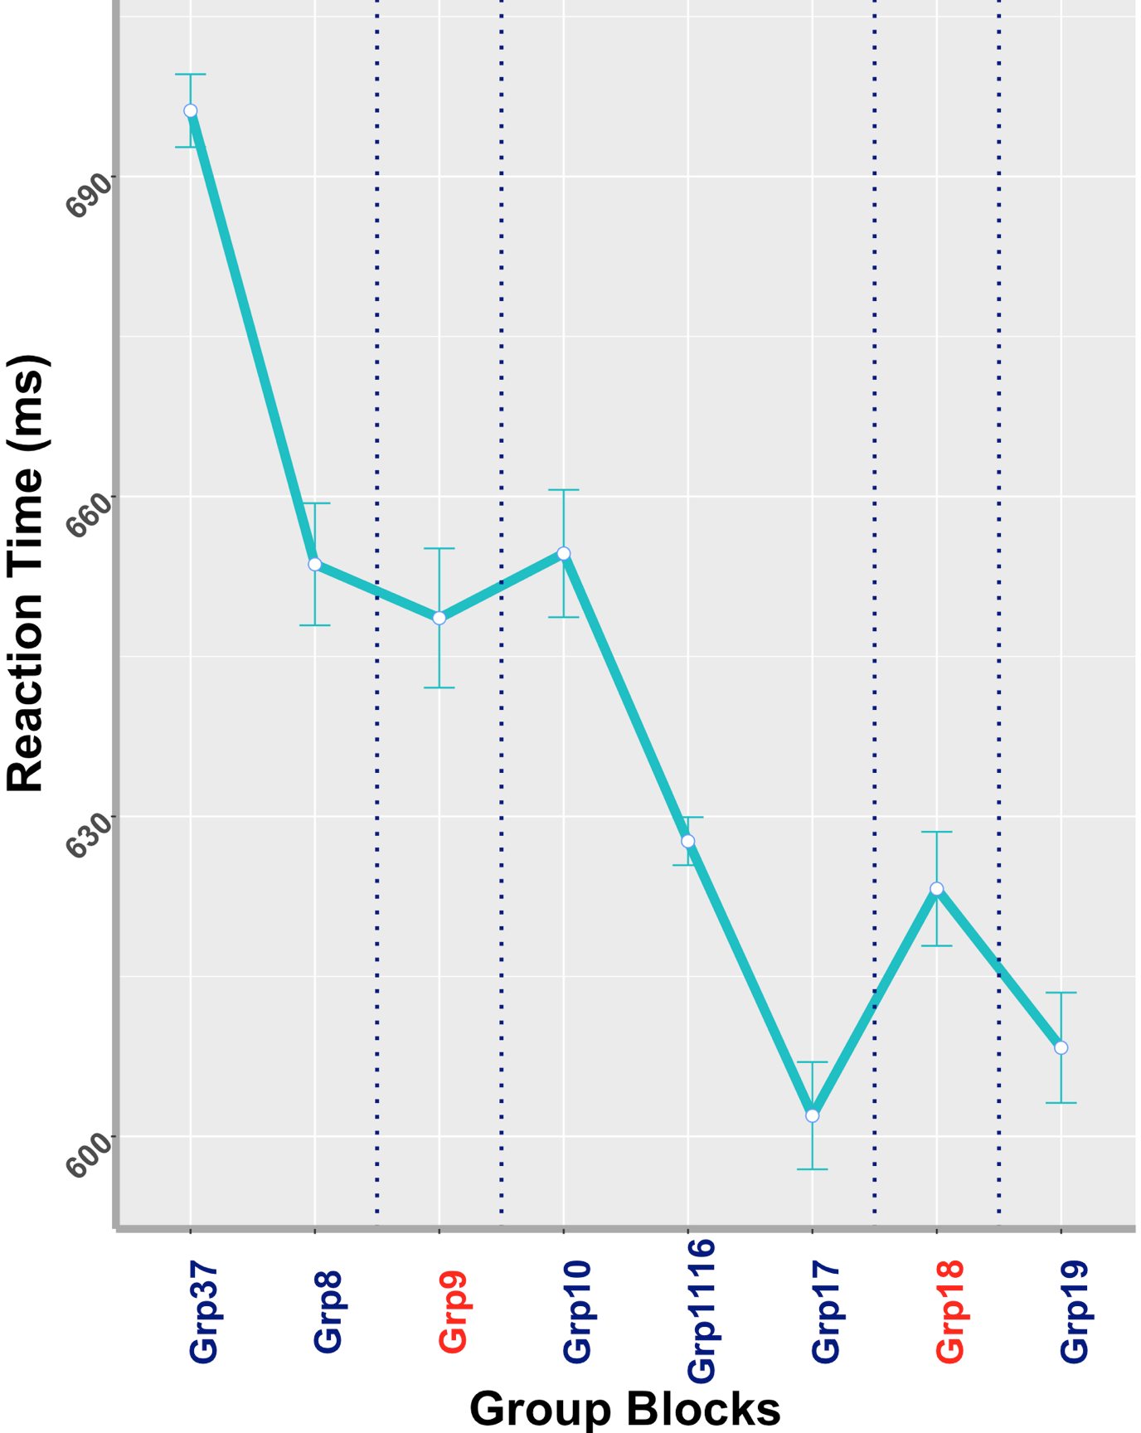
Experiment 1
Questions:
Can people learn the sequence implicitly and without the association with their motor responses? YES
When the sequence learning will happen (during the first or second half of the experiment)? Only second transition block
Right
Intro.
.
QY
Trans block 1
Trans block 2
QY
OX
Exp1.
YQ
Res1.
Sum.
*
Disc.
Fut.
30 subjects

Slide 12
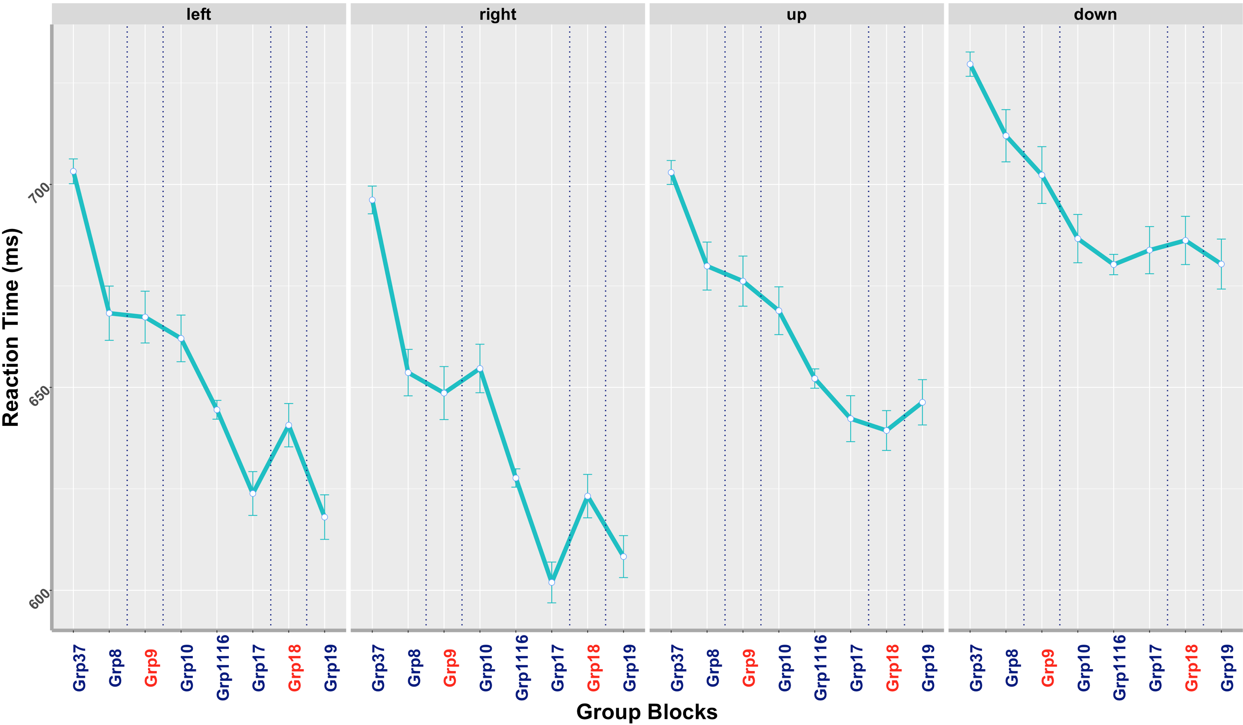
Questions:
3. Do the position of the targets (XO/OX) affect the sequence learning? YES
Intro.
Trans block 1
Trans block 2
Trans block 1
Trans block 2
Trans block 1
Trans block 2
Trans block 1
Trans block 2
Exp1.
Res1.
Sum.
*
Disc.
*
Fut.
30 subjects

Slide 13
In Exp. 1:
Participants exhibited a general improvement on sequential blocks, faster RTs.
How much of their learning is by an acquisition of sequence-specific/ predictive knowledge?
Intro.
Exp1.
Res1.
Sum.
Disc.
Fut.

Slide 14
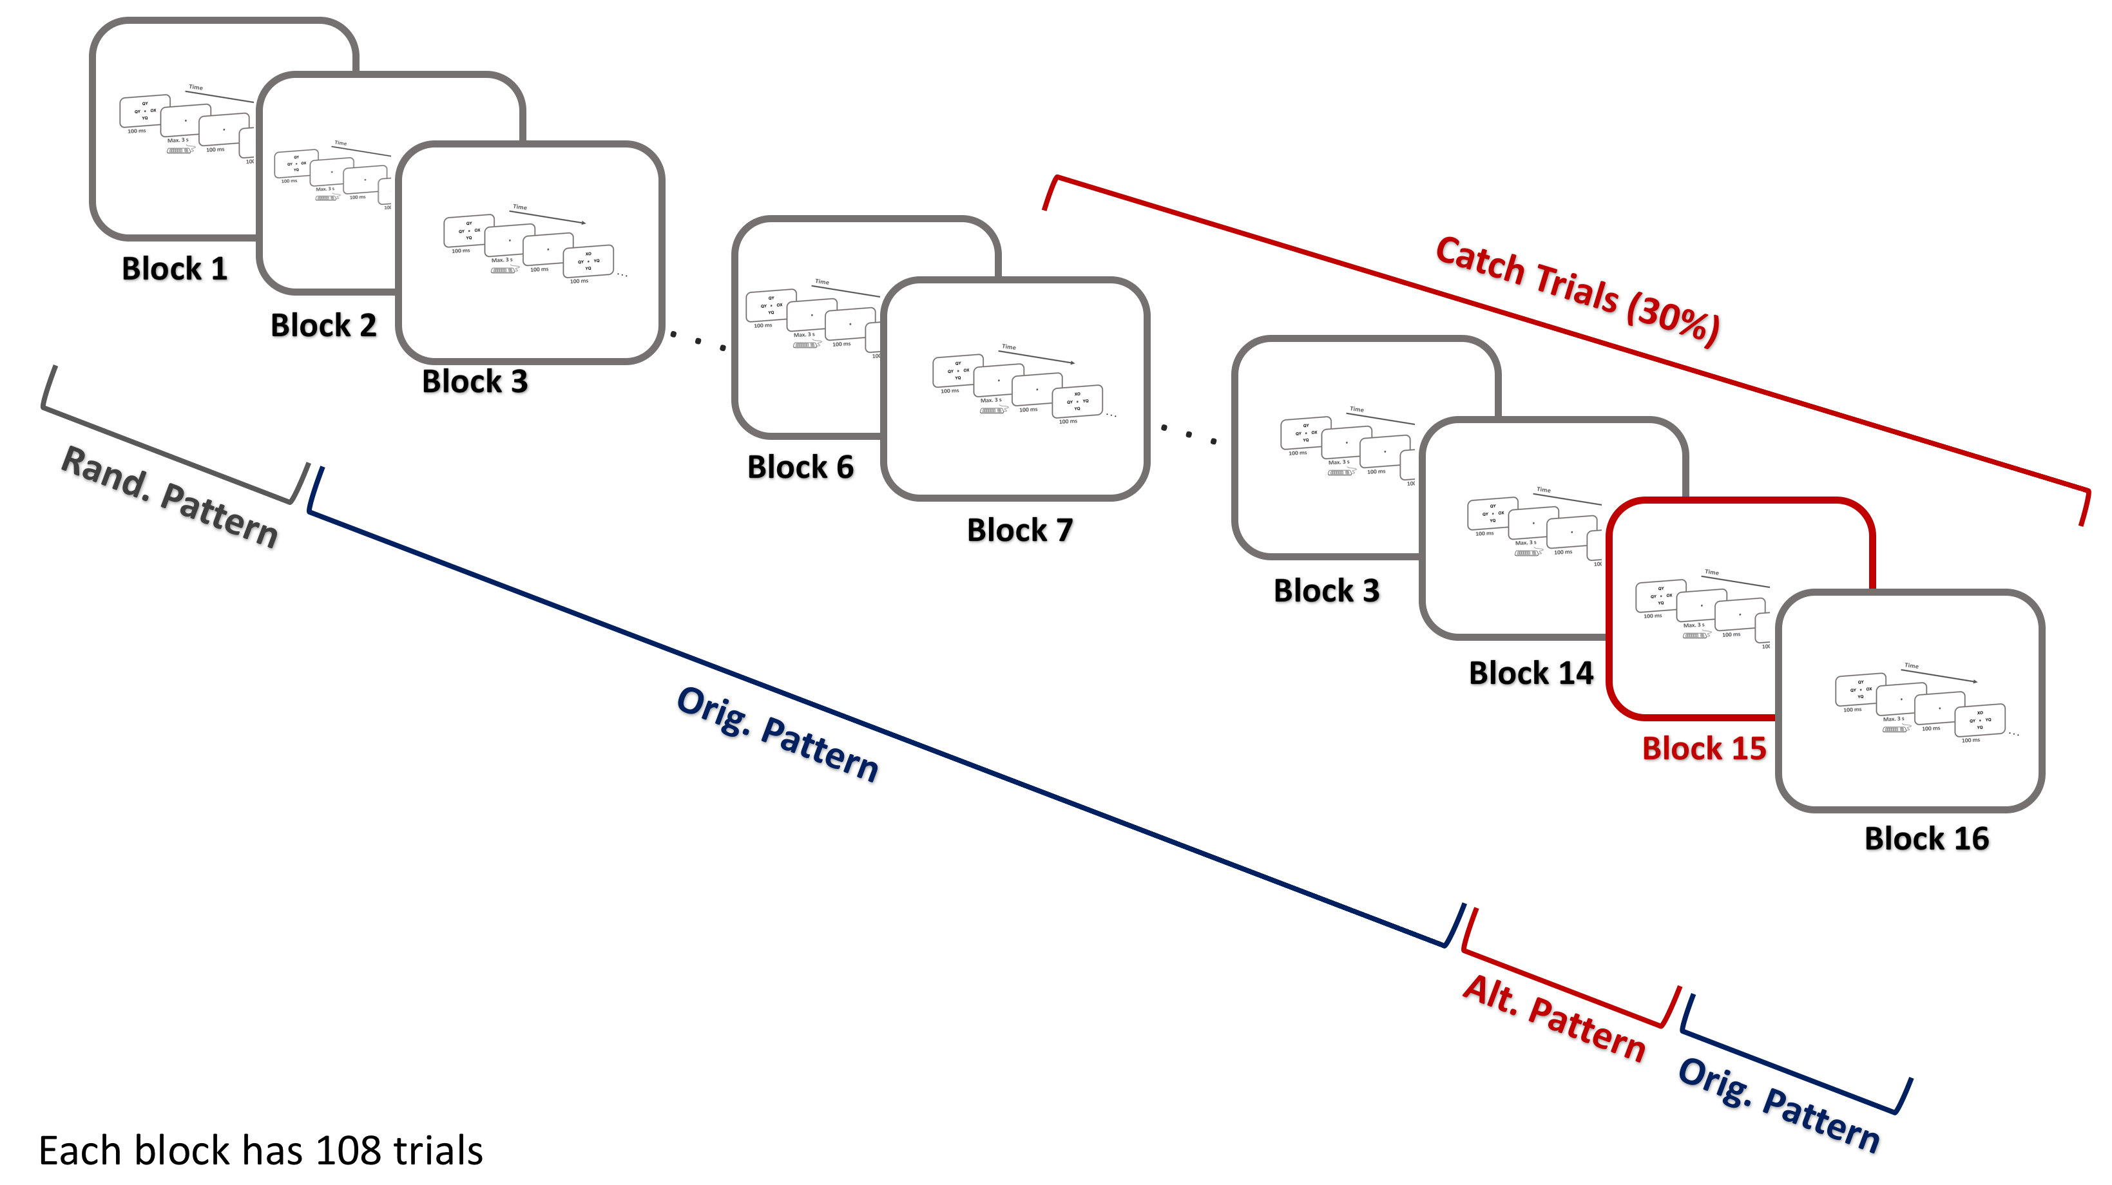
Experiment 2
Intro.
Goal:
Measuring a trial-by-trial predictive learning
Add catch trials to the experiment
Questions:
Can people still learn the sequence implicitly after adding the catch trials?
Do the position of the targets (XO/OX) affect learning? Similar trend as experiment 1?
Exp2.
Res.
Sum.
Disc.
Fut.

Slide 15
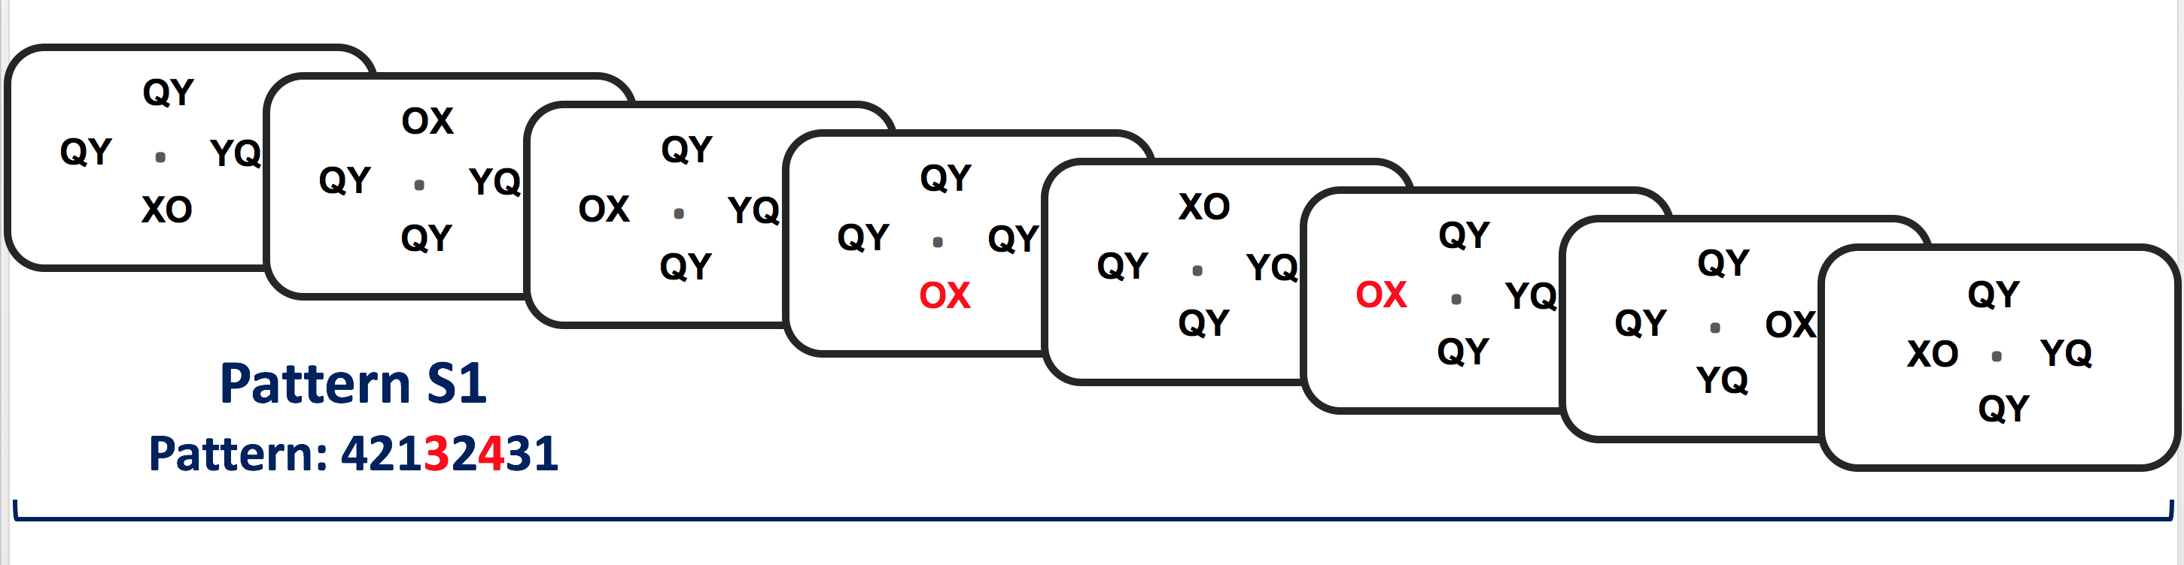
Intro.
Exp2.
Res.
Sum.
Disc.
Predicted, 70 %
Catch, 30 %
Fut.

Slide 16
Intro.
Exp2.
Res.
Sum.
Disc.
Fut.

Slide 17
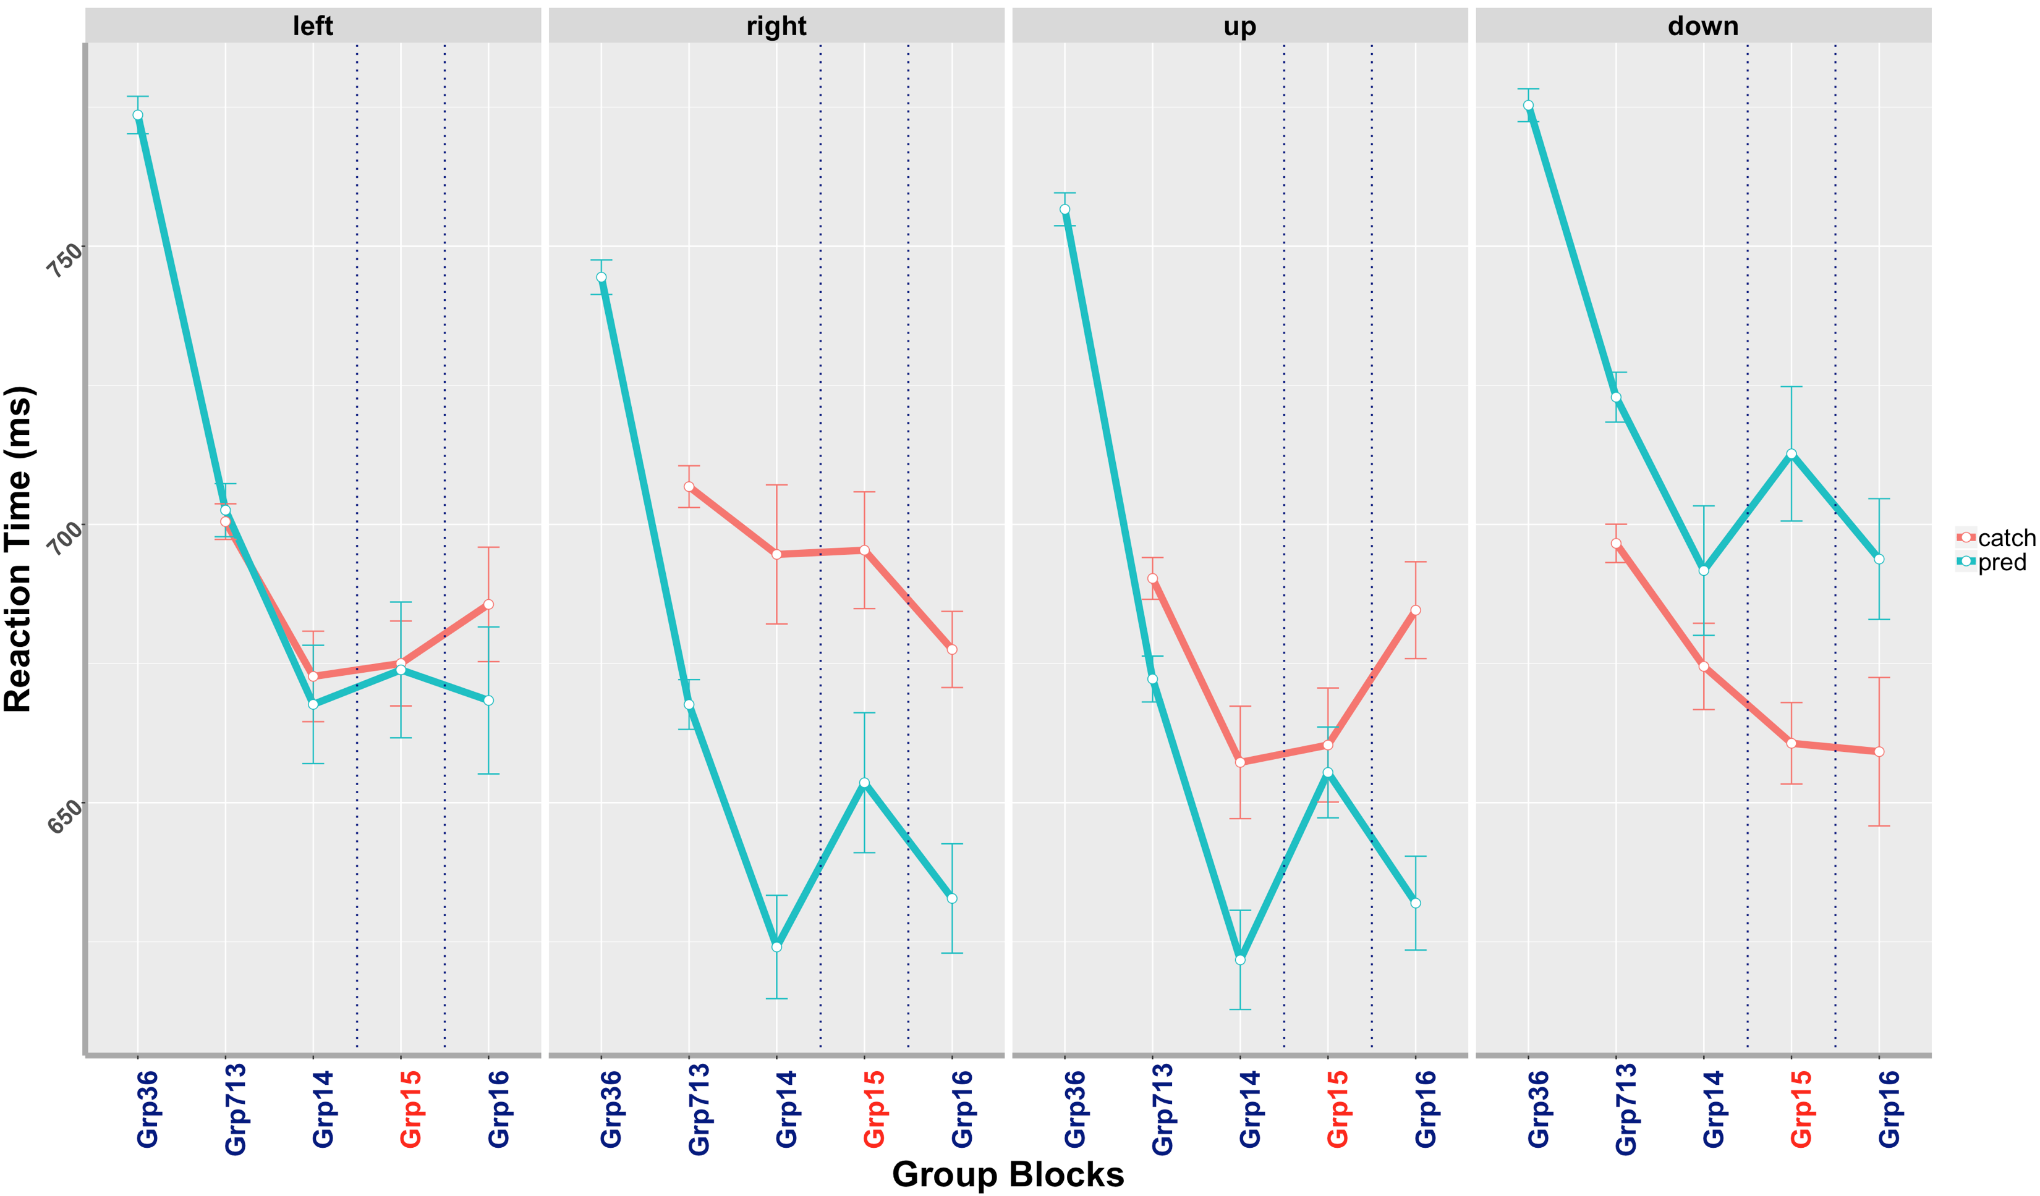
Questions:
Can people still learn the sequence implicitly after adding the catch trials? YES, but not in all positions
Intro.
Exp2.
Res2.
*
*
*
Sum.
Disc.
Fut.
54 subjects

Slide 18
Questions:
2. Do the position of the targets (XO/OX) affect learning? Similar trend as experiment 1?
Only for the right position
Intro.
Exp2.
Res2.
*
*
*
Sum.
Disc.
Fut.
54 subjects

Slide 19
In Exp. 2:
Participants exhibited a general improvement on sequential blocks, faster RTs.
Participants exhibited a sequence-specific/predictive learning, only in the right position
Question:
What is the role of alpha-band frequency?
Intro.
Exp2.
Res2.
Sum.
Disc.
Fut.

Slide 20
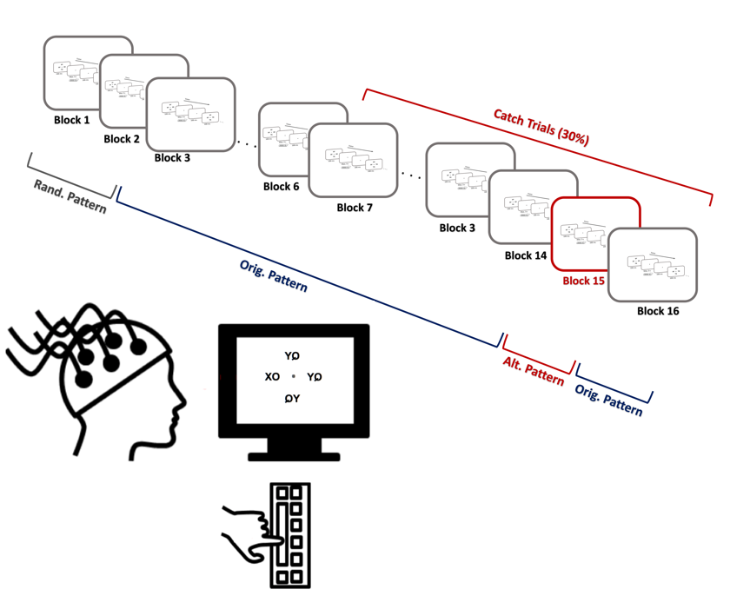
Experiment 2.1
Intro.
Goal:
Investigate the role of alpha-band frequency
Questions:
Does the behavioral data replicate?
What is the role of alpha-band phase in predictive learning?
Exp2.1.
Res.
Sum.
Disc.
Fut.

Slide 21
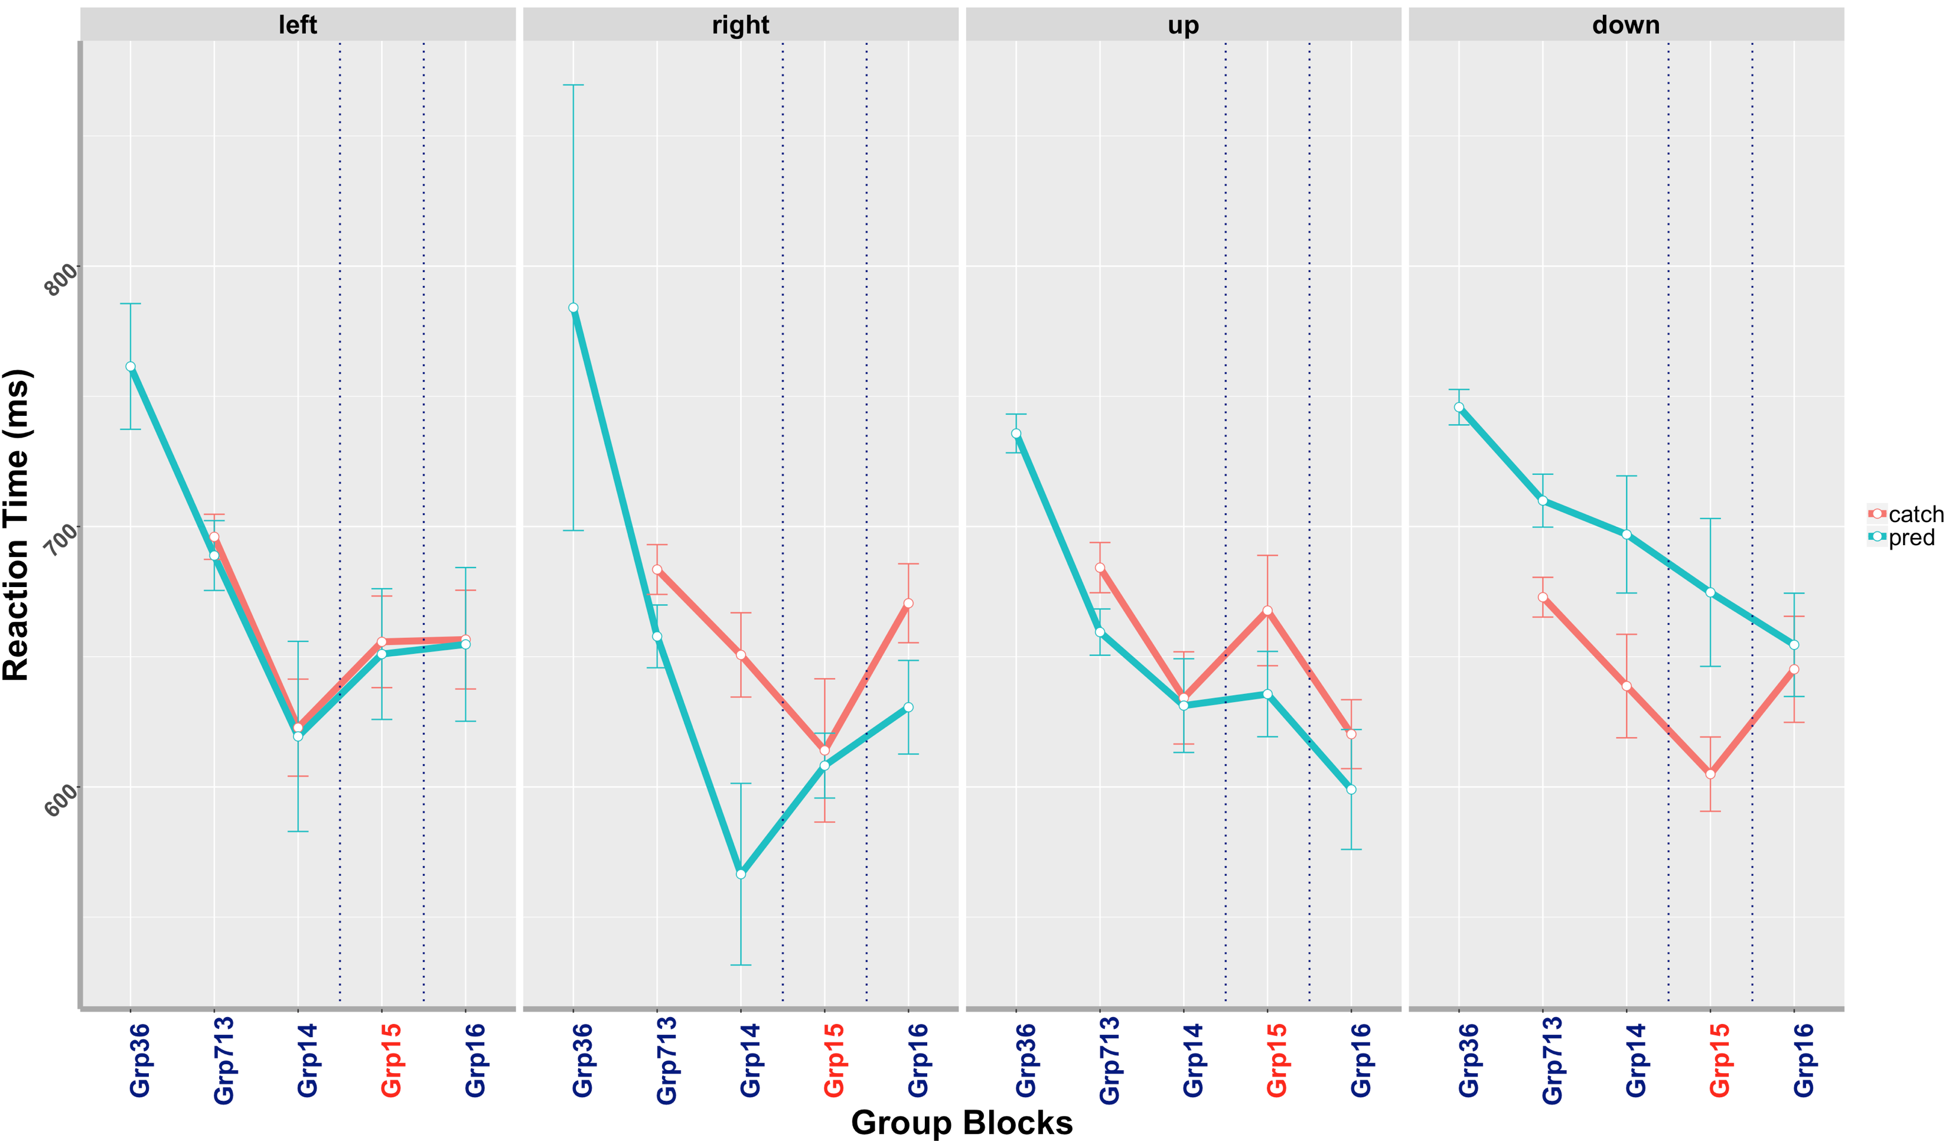
Questions:
Does the behavioral data replicate?
Similar trend, not sig. yet.
Intro.
Exp2.1.
Res2.1.
Sum.
Disc.
Fut.
11 subjects

Slide 22
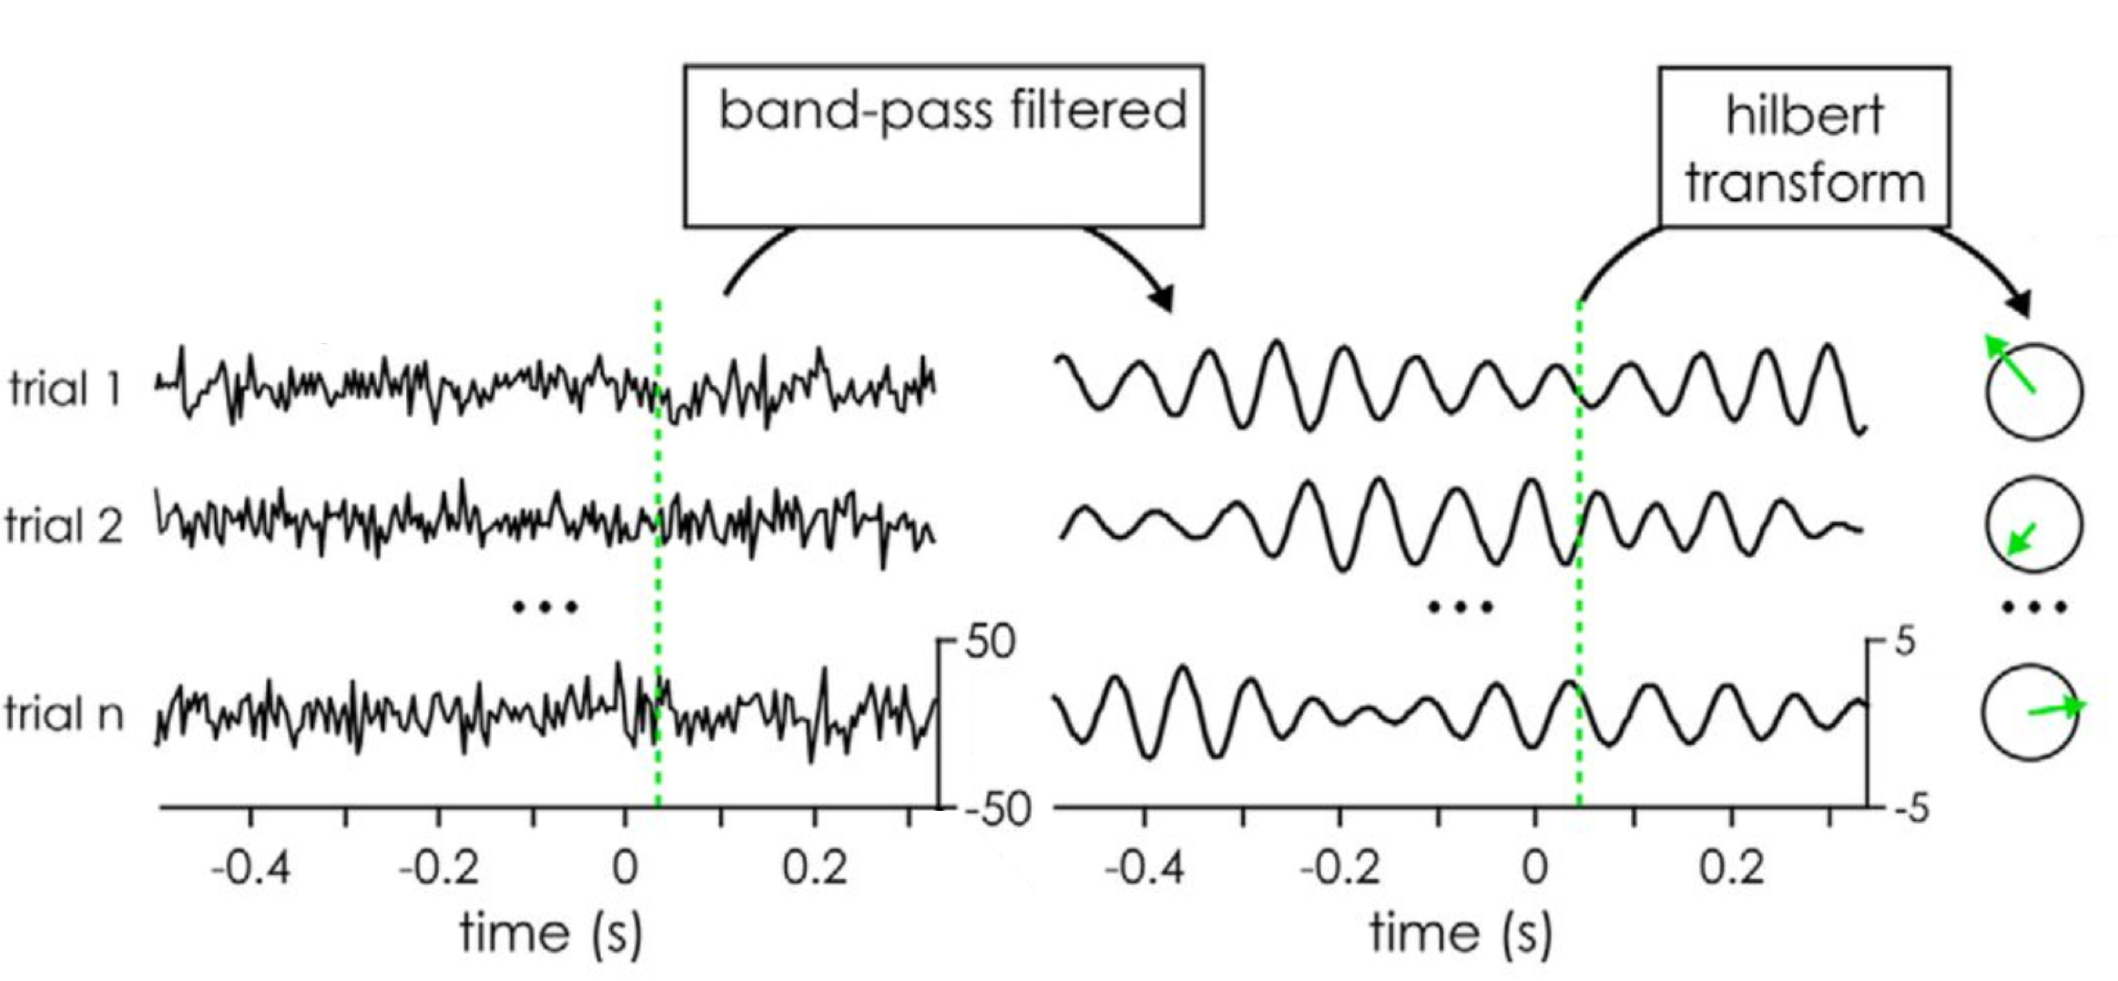
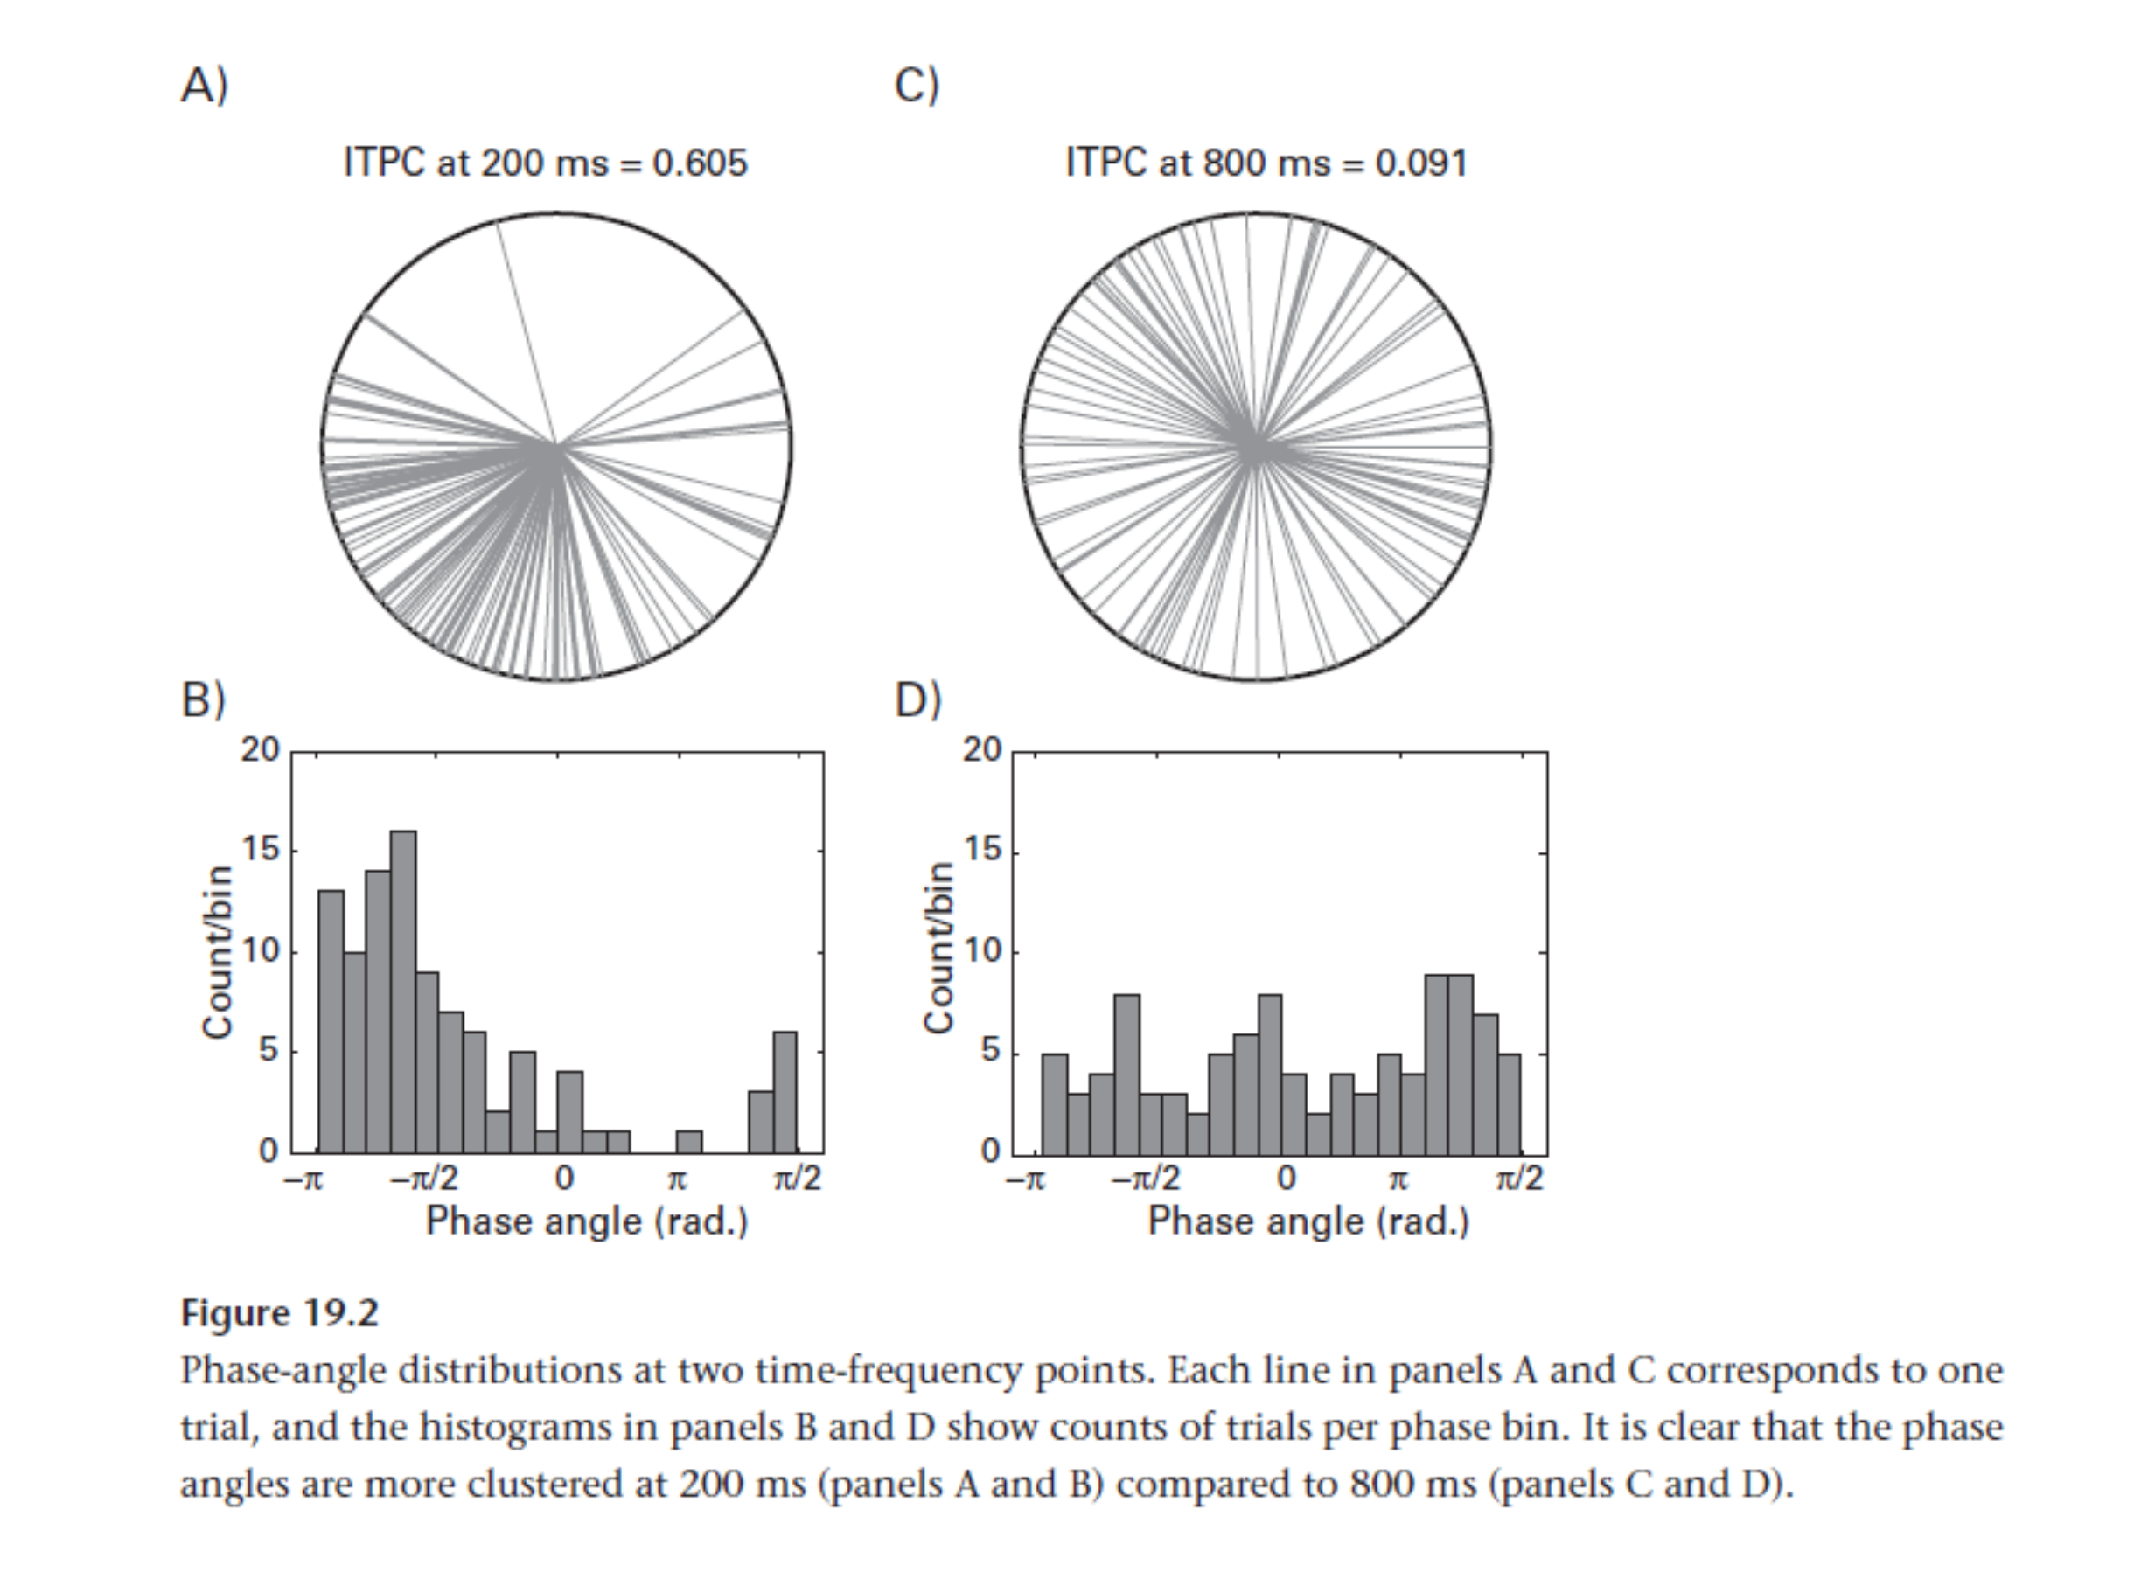
Inter Trial Coherence
Questions:
2. What is the role of alpha-band phase in predictive learning?
Intro.
Exp2.1.
Res2.1.
Sum.
Disc.
Fut.
Timing of the oscillations, timing is embedded in phase.
ITC > ITC
Cohen, M.X., 2014. “Analyzing neural time series data : theory and practice”, Cambridge, Massachusetts : The MIT Press.

Slide 23
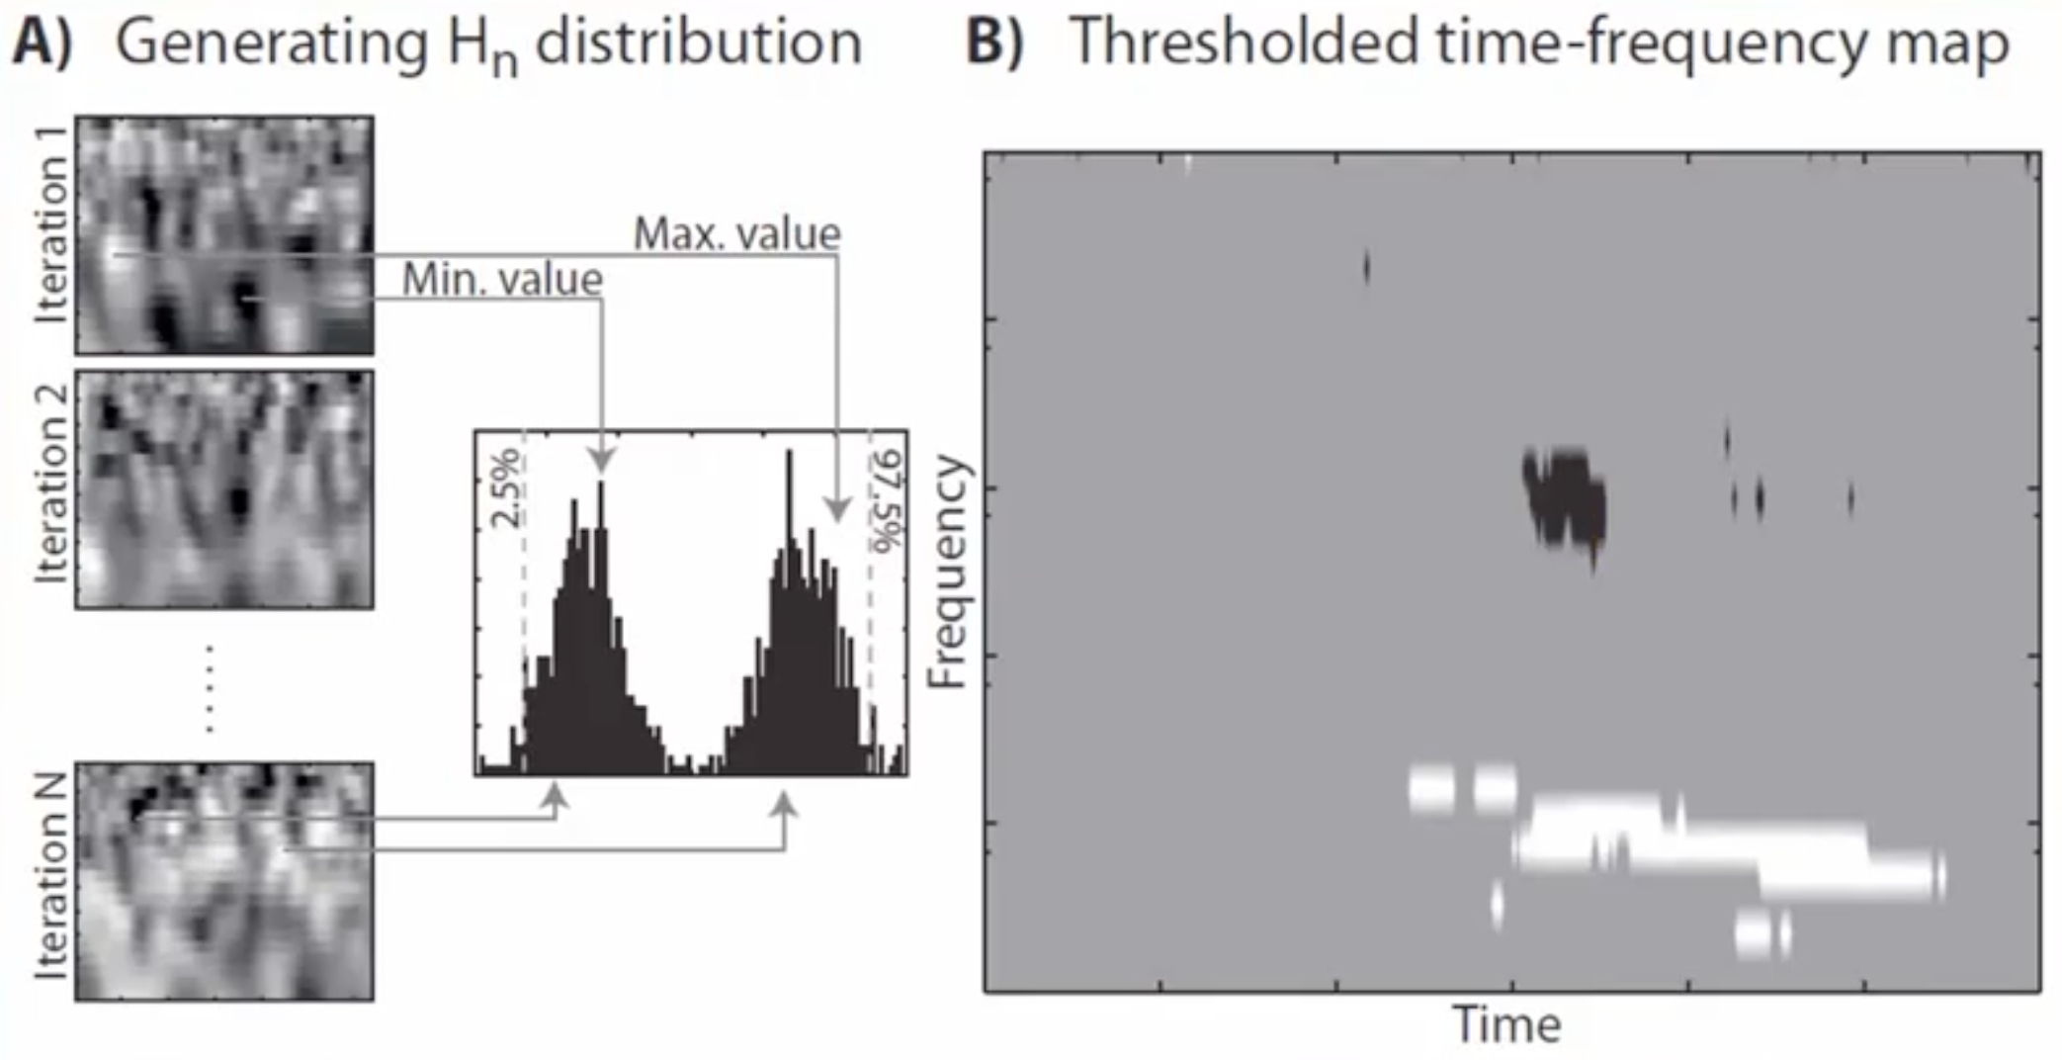
Cluster-based correction
Cohen, M.X., 2014. “Analyzing neural time series data : theory and practice”, Cambridge, Massachusetts : The MIT Press.

Slide 24
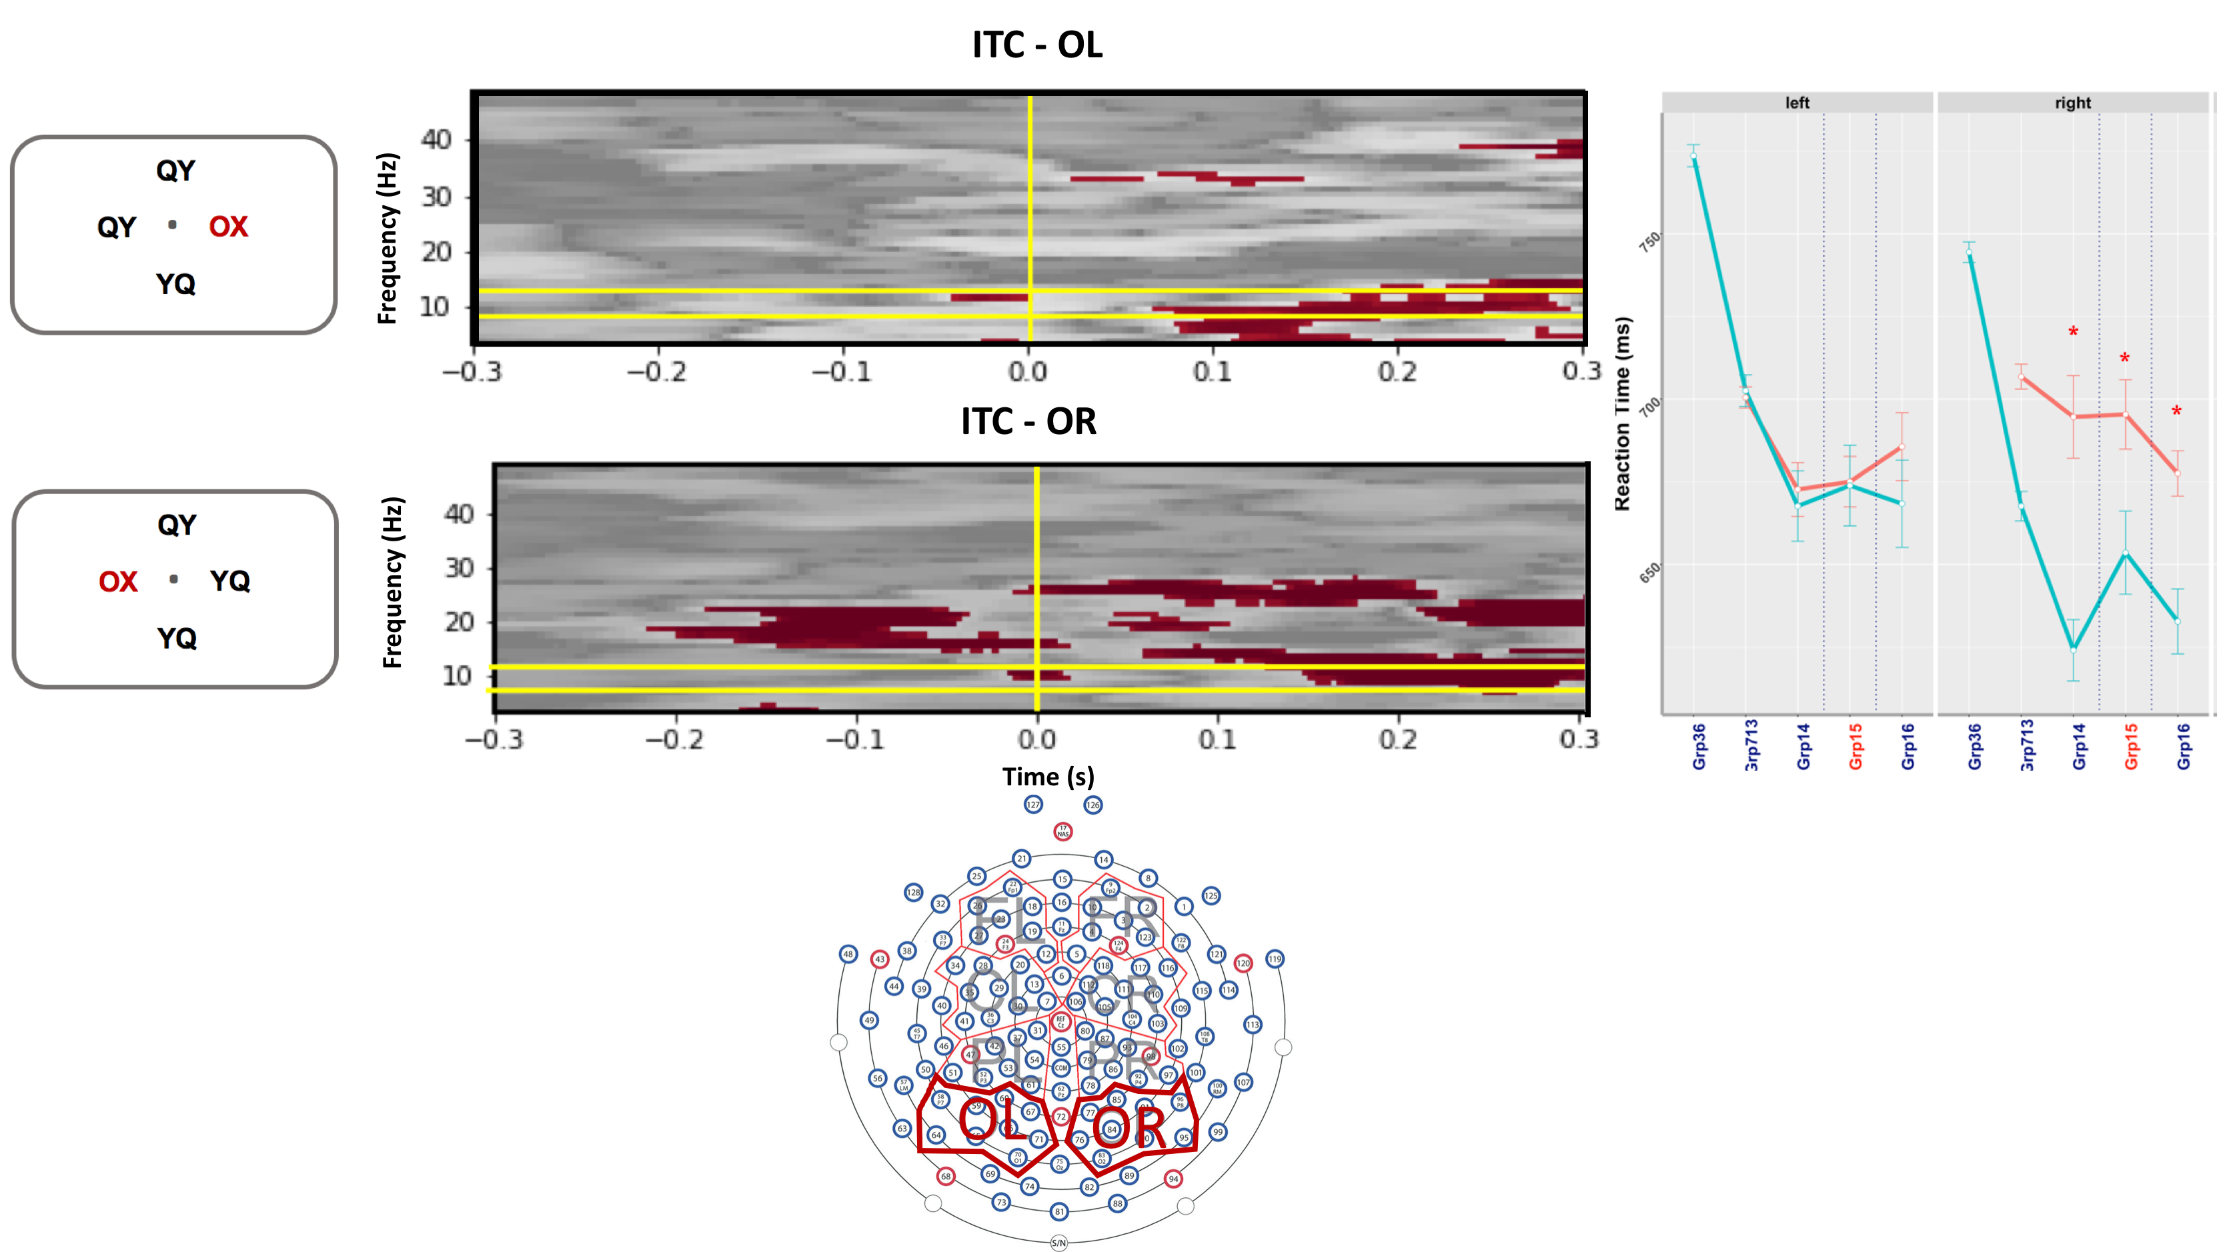
Block 3 – 6 Vs Block 7-13
Contralateral ROIs
Intro.
Exp2.1.
Res2.1.
Sum.
Disc.
Fut.

Slide 25
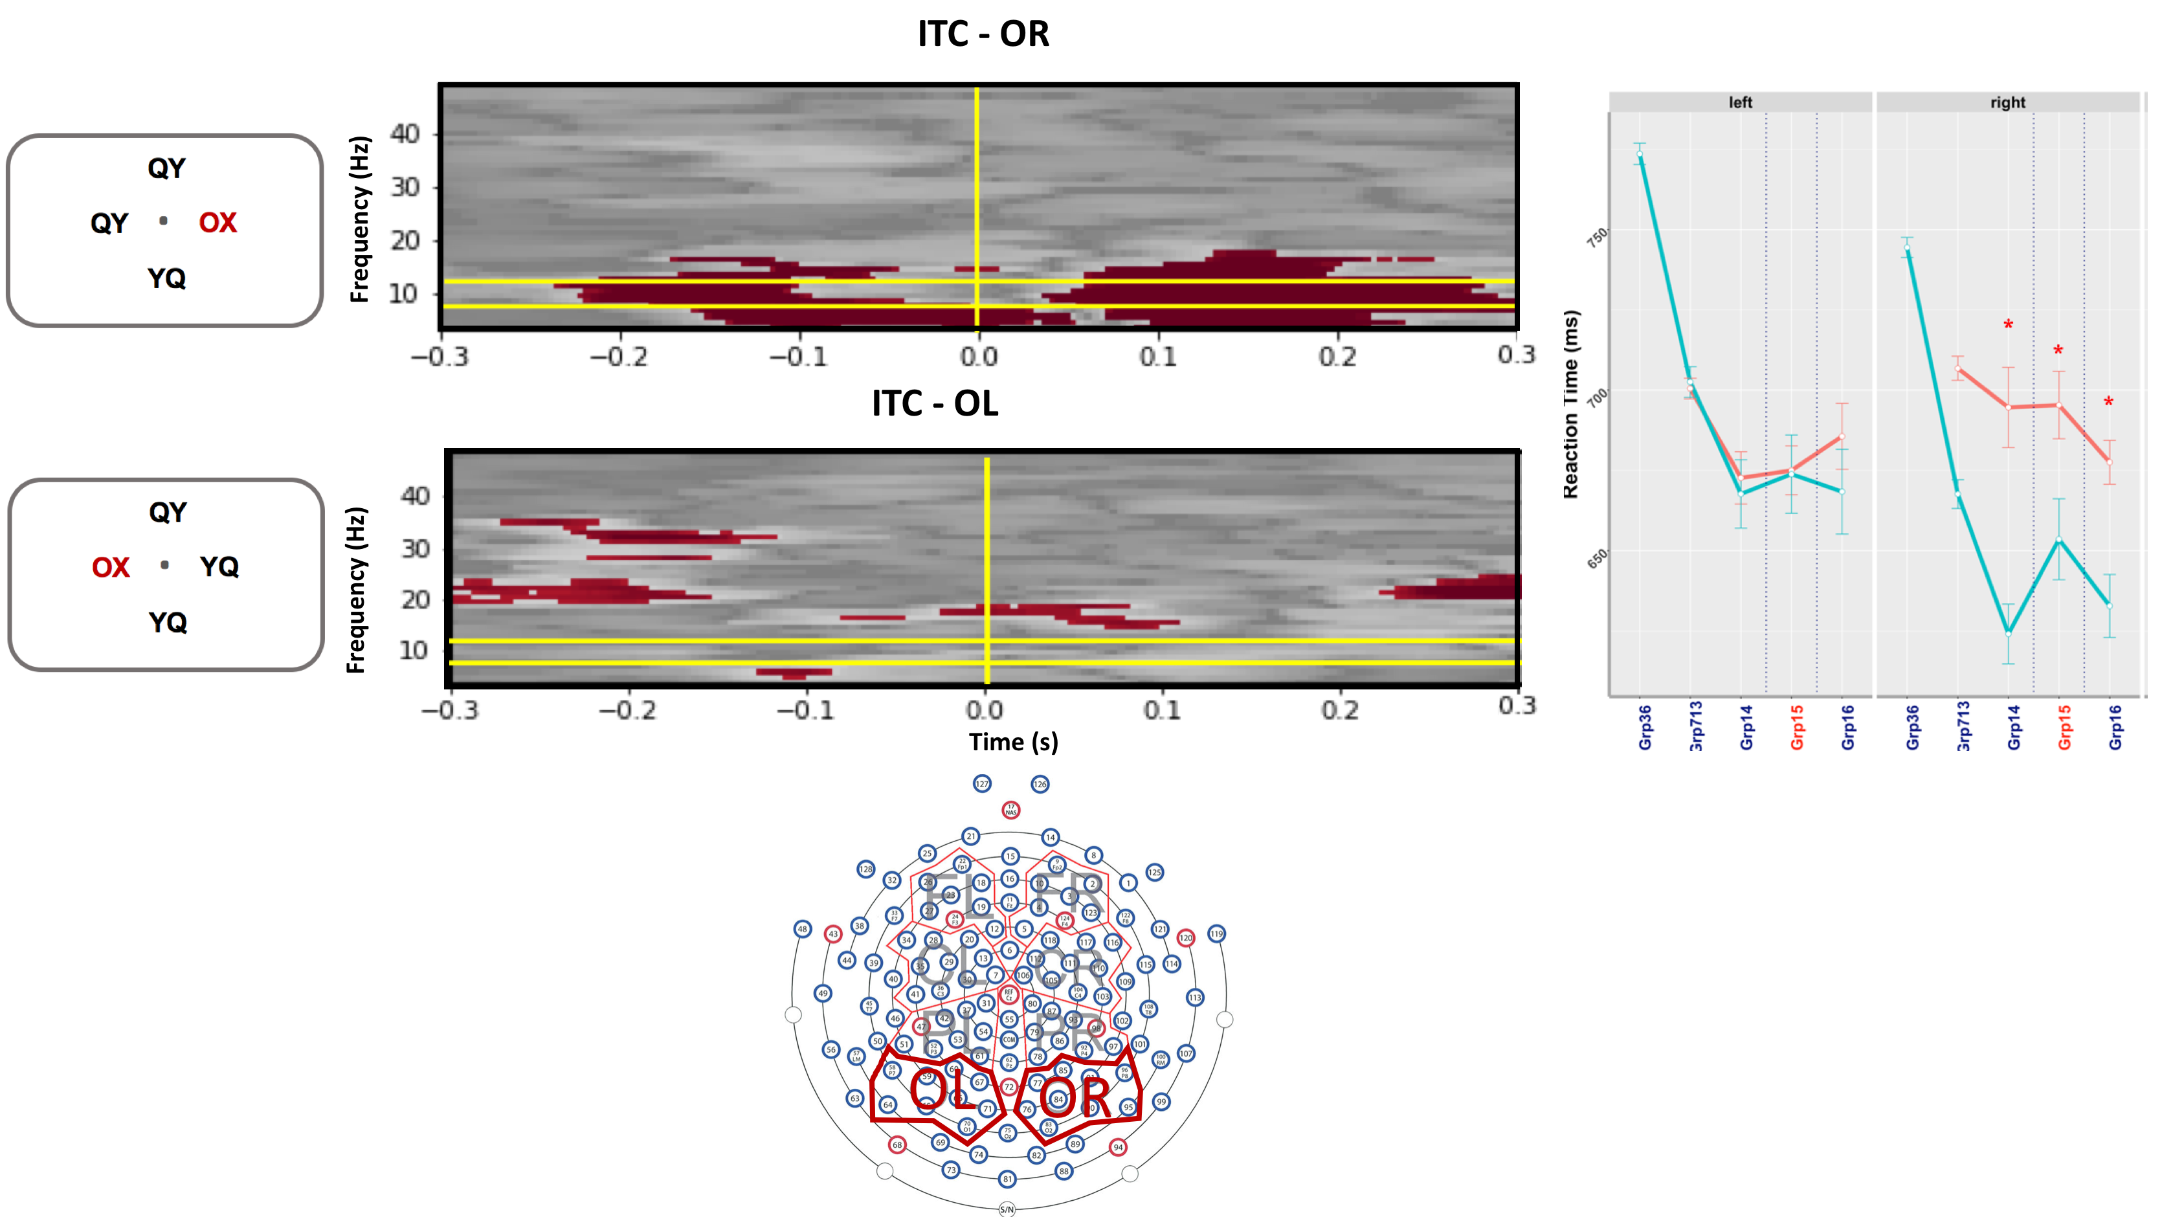
Block 3 – 6 Vs Block 7-13
Ipsilateral ROIs
Intro.
Exp2.1.
Res2.1.
Sum.
Disc.
Fut.

Slide 26
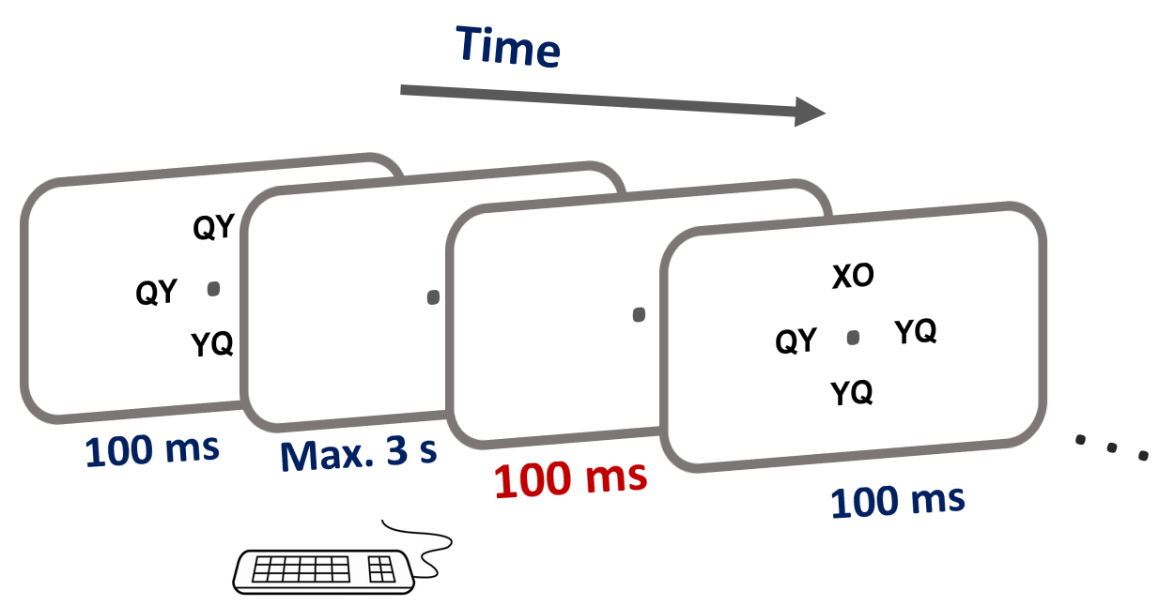
Exp. 2
Intro.
Exp3.
Res.
Sum.
Disc.
100 ms Inter Stimulus Interval is not enough for the pre-stimulus analysis
Fut.

Slide 27
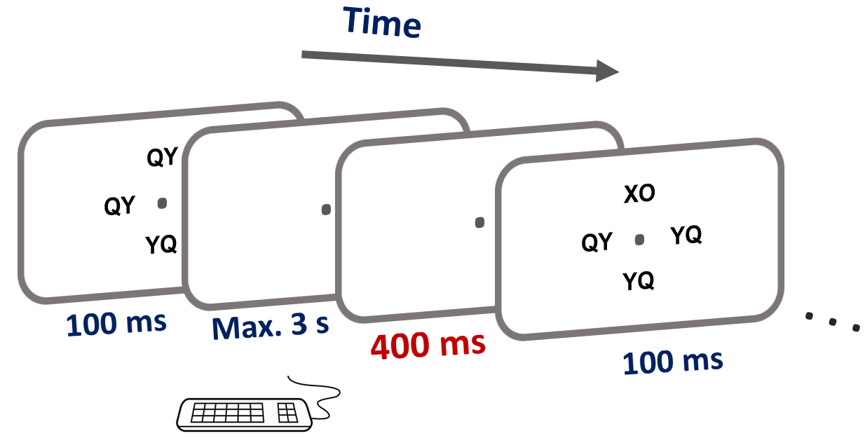
Experiment 3
Intro.
Goal:
Investigate the role of alpha-band frequency
Questions:
After increasing the timing between two continuous trials, can participants still learn implicitly?
What is the role of alpha-band phase in predictive learning?
Exp3.
Res.
Sum.
Disc.
Fut.

Slide 28
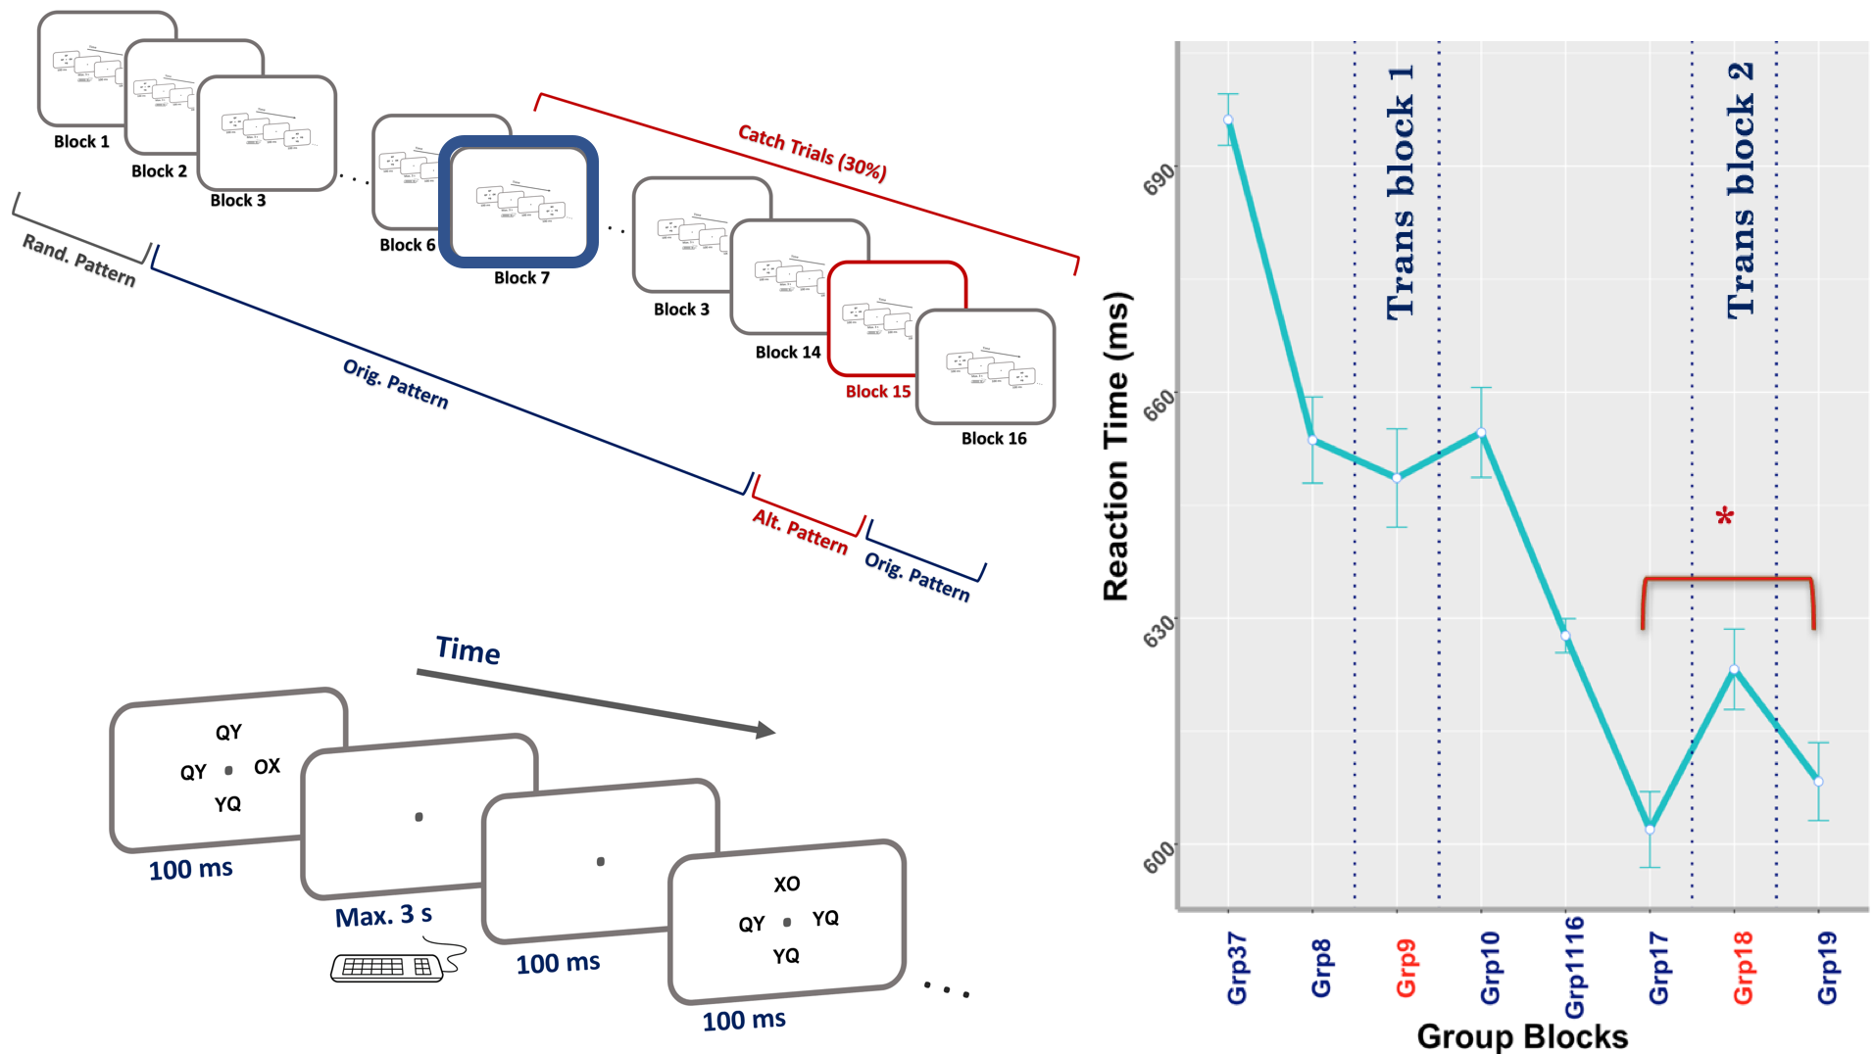
Exp. 1
Exp. 2
Intro.
Exp3.
Res.
Sum.
Disc.
Participants did not exhibit a sequential learning on the first transition block.
Added catch trials after Block 7
Fut.

Slide 29
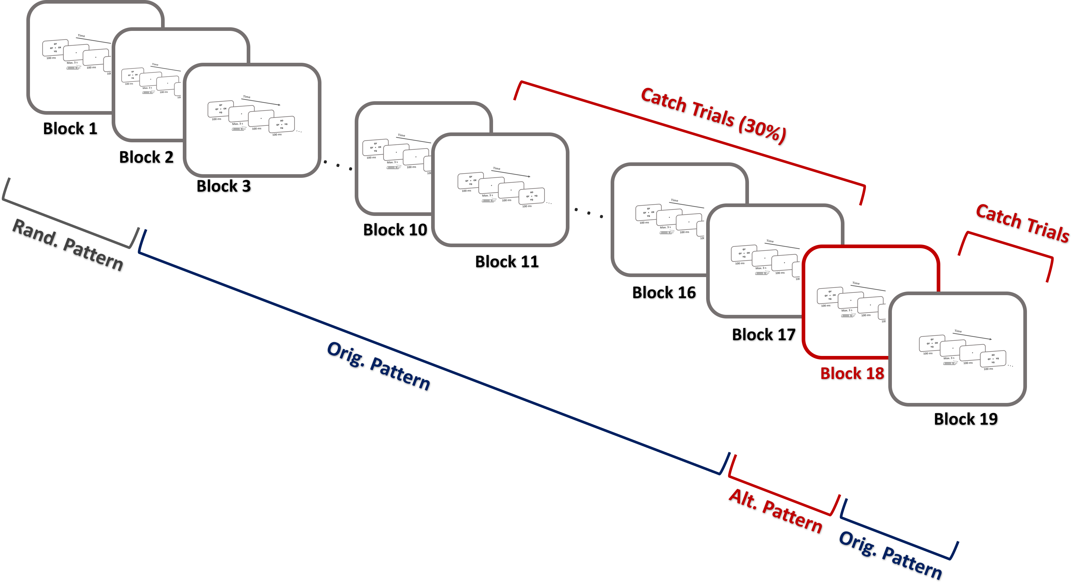
Experiment 3
Intro.
Exp3.
Res.
Sum.
Disc.
Fut.

Slide 30
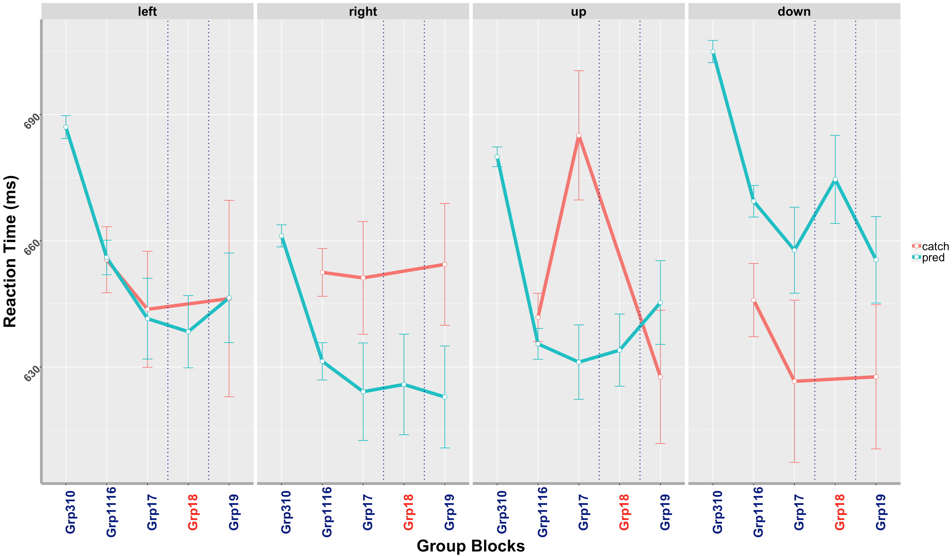
Questions:
After increasing the timing between two continuous trials, can participants still learn implicitly?
No. Sig difference. Similar trend.
Intro.
*
Exp3.
Trans block
Trans block
Res3.
Sum.
Disc.
Trans block
Trans block
Fut.
20 subjects
With EEG

Slide 31
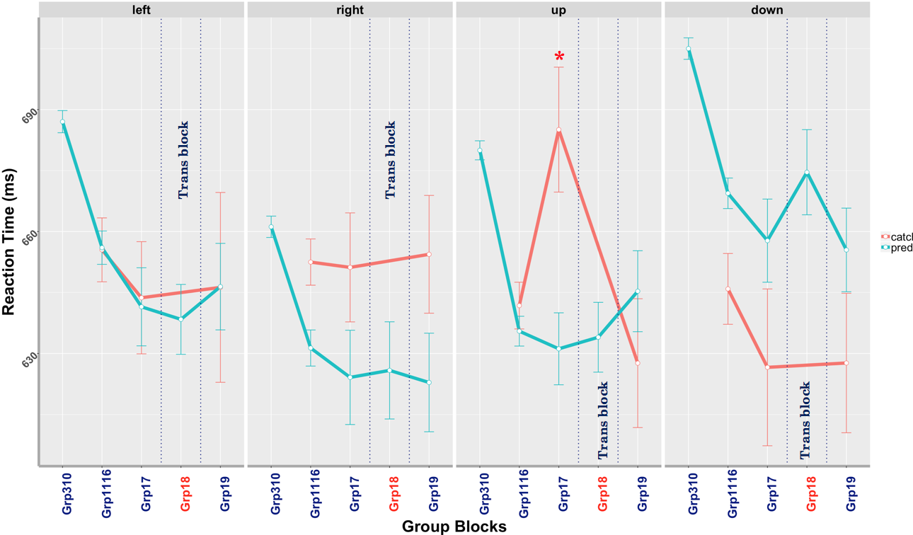
Intro.
Exp. 2.1.
Exp. 3
Exp3.
Res3.
Sum.
Disc.
Fut.
11 subjects
With EEG
20 subjects
With EEG

Slide 32
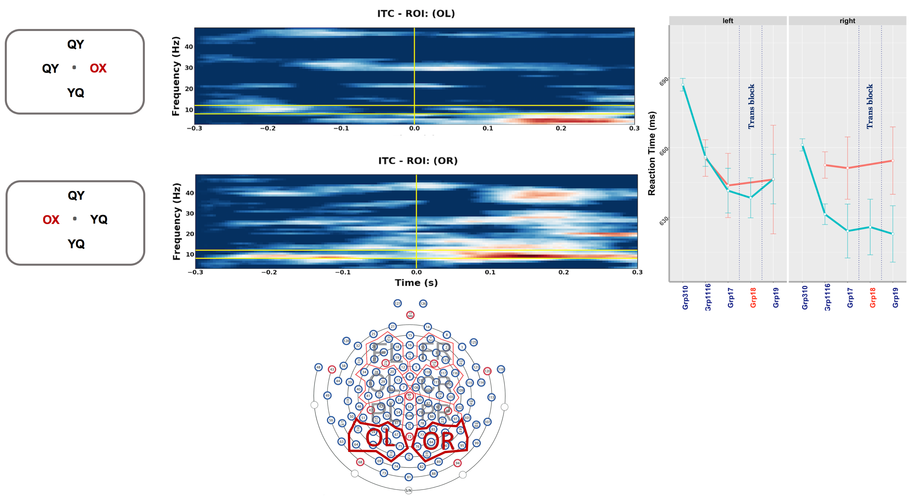
Block 11 – 16 _ Predicted vs Catch trials
Contralateral ROIs
Intro.
Exp3.
Res3.
Sum.
Disc.
Fut.

Slide 33
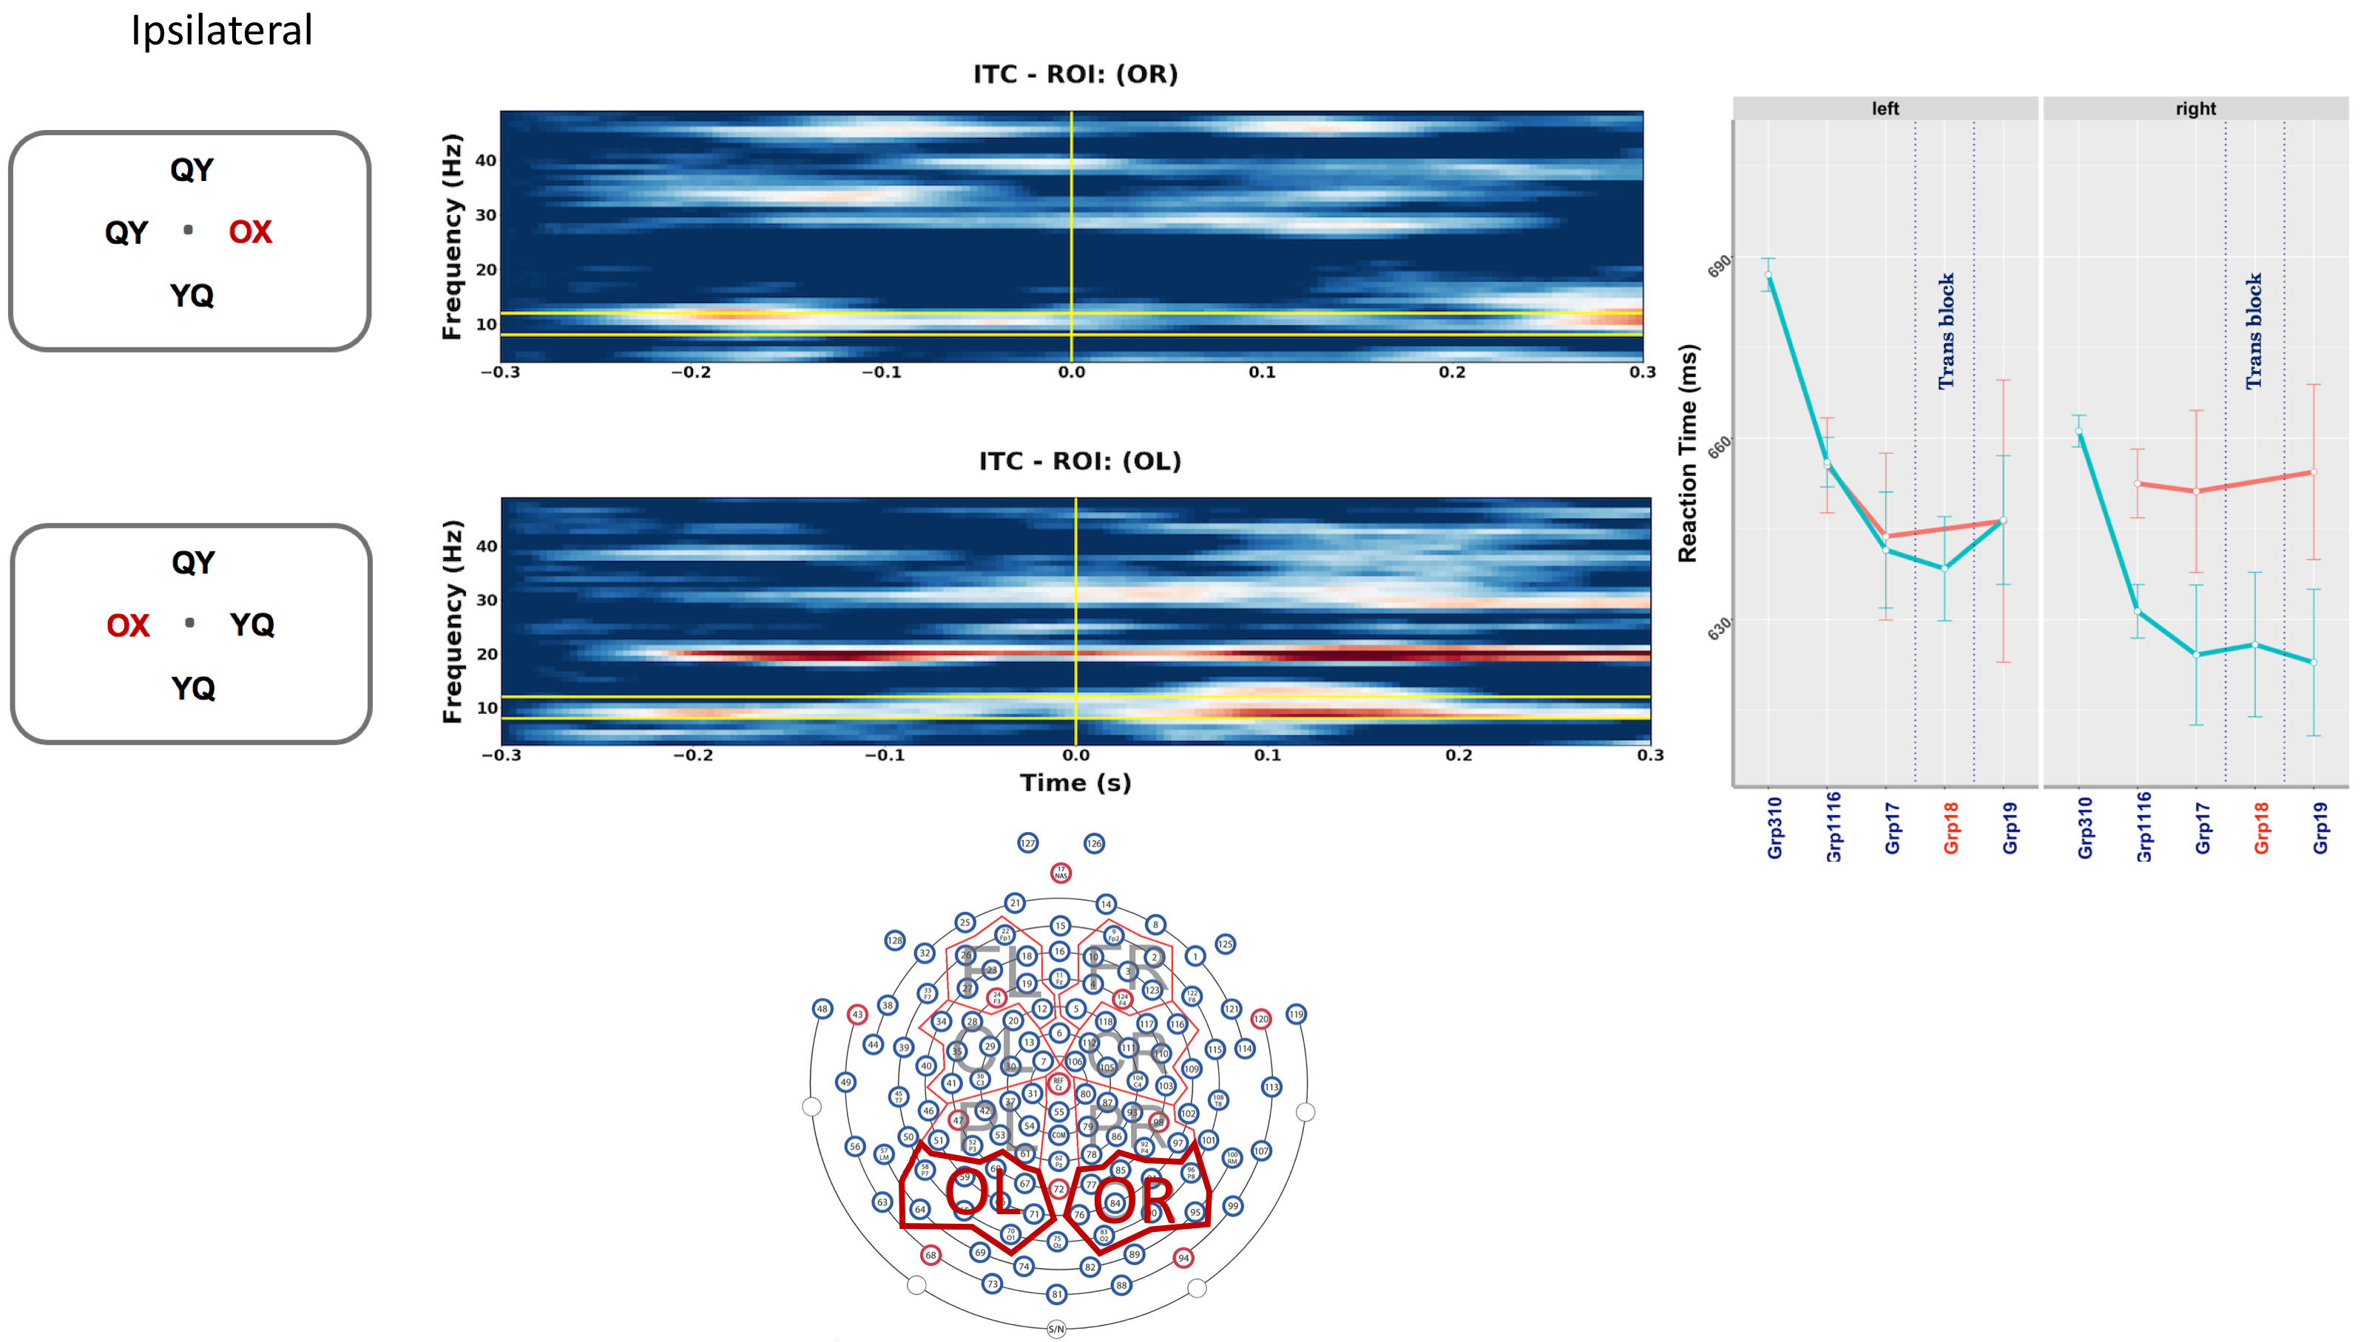
Block 11 – 16 _ Predicted vs Catch trials
Ipsilateral ROIs
Intro.
Exp3.
Res3.
Sum.
Disc.
Fut.

Slide 34
Summary
Hypothesis:
Every alpha cycle (~100 msec) the brain repeats a prediction-followed-by-outcome learning episode.
What we did:
We have designed a sequential learning experiment where subjects have implicitly learned what will happen next. Our behavioral results showed a learning trend over time.
To investigate whether top-down modulation of brain oscillations accounts for this learning, we have recorded EEG signals.
What our preliminary results showed:
A pre-stimulus alpha synchronization contralateral to the location of the stimulus.
Intro.
Exp.
Res.
Sum.
Disc.
Fut.

Slide 35
Discussion
Intro.
We presented our stimuli in ~10 Hz ( entrainment specific to ∼10 Hz stimulation), Could it be the reason for the alpha activity?
Previous entrainment studies targeting the visual system have shown that
Even non-rhythmic input can result in cortical 10 Hz resonance (VanRullen and Macdonald, 2012).
Also, rhythmic stimulation at frequencies other than 10 Hz was shown to induce a 10 Hz rhythmicity in perceptual performance (de Graaf et al., 2013).
Exp.
Res.
Sum.
Disc.
Fut.

Slide 36
Future steps
Intro.
Source analysis
Cross frequency coupling (e.g., the interaction between gamma and alpha during the predictive learning)
Phase amplitude coupling
Shifting in phase from -100 to 100 in different brain oscillations
Exp.
Res.
Sum.
Disc.
Fut.

Slide 37
Acknowledgement
Intro.
My Supervisors and committees
Randall O’Reilly
Tim Curran
Al Kim
Computational Neural Network Lab
John Rohrlich
Tom Hazy
Seth Herd
Jake Russin
Kai Krueger
Ananta Nair
Exp.
Res.
Sum.
Disc.
Fut.

Slide 38
Intro.
END
and
Thanks!
Exp.
Res.
Sum.
Disc.
Fut.

Slide 39
References
Cohen, M.X., 2014. Analyzing neural time series data : theory and practice, Issues in clinical and cognitive neuropsychology. Cambridge, Massachusetts : The MIT Press.
de Graaf, T.A., Gross, J., Paterson, G., Rusch, T., Sack, A.T., Thut, G., 2013. Alpha-band rhythms in visual task performance: Phase-locking by rhythmic sensory stimulation. PLoS One 8.
Deroost, N., Soetens, E., 2006. Spatial Processing and Perceptual Sequence Learning in SRT Tasks. Exp. Psychol. 53, 16–30. https://doi.org/10.1027/1618-3169.53.1.16
Fiebelkorn, I.C., Kastner, S., 2019. A Rhythmic Theory of Attention. Trends Cogn. Sci. 23, 87–101. https://doi.org/10.1016/j.tics.2018.11.009
Reuter-Lorenz, P.A., Fendrich, R., 1990. Orienting Attention across the Vertical Meridian: Evidence from Callosotomy Patients. J. Cogn. Neurosci. 2, 232–238. https://doi.org/10.1162/jocn.1990.2.3.232
VanRullen, R., Macdonald, J.S.P., 2012. Perceptual Echoes at 10 Hz in the Human Brain. Curr. Biol. 22, 995–999. https://doi.org/10.1016/j.cub.2012.03.050

